Slide 1

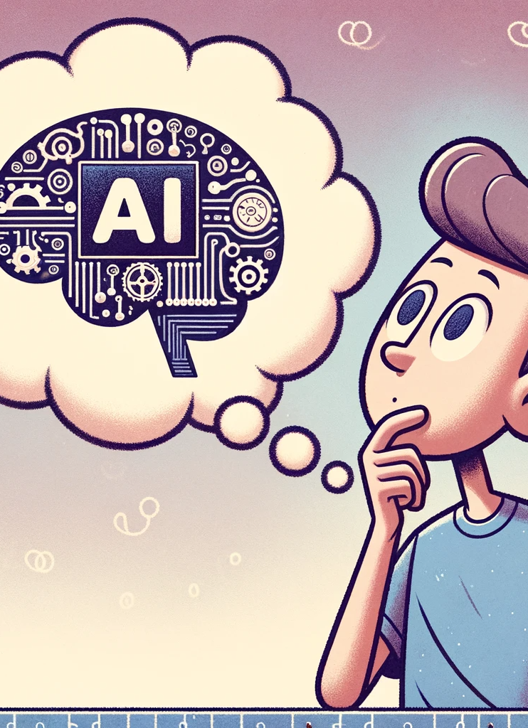
Foundations of AI and AI Best Practices Masterclass
Project Management Institute

Slide 2
Course Structure
Introductions
The Fundamentals of AI
Applications & ROI of AI
Causes of AI Project Failure
Data-Centric AI Methodologies

Slide 3

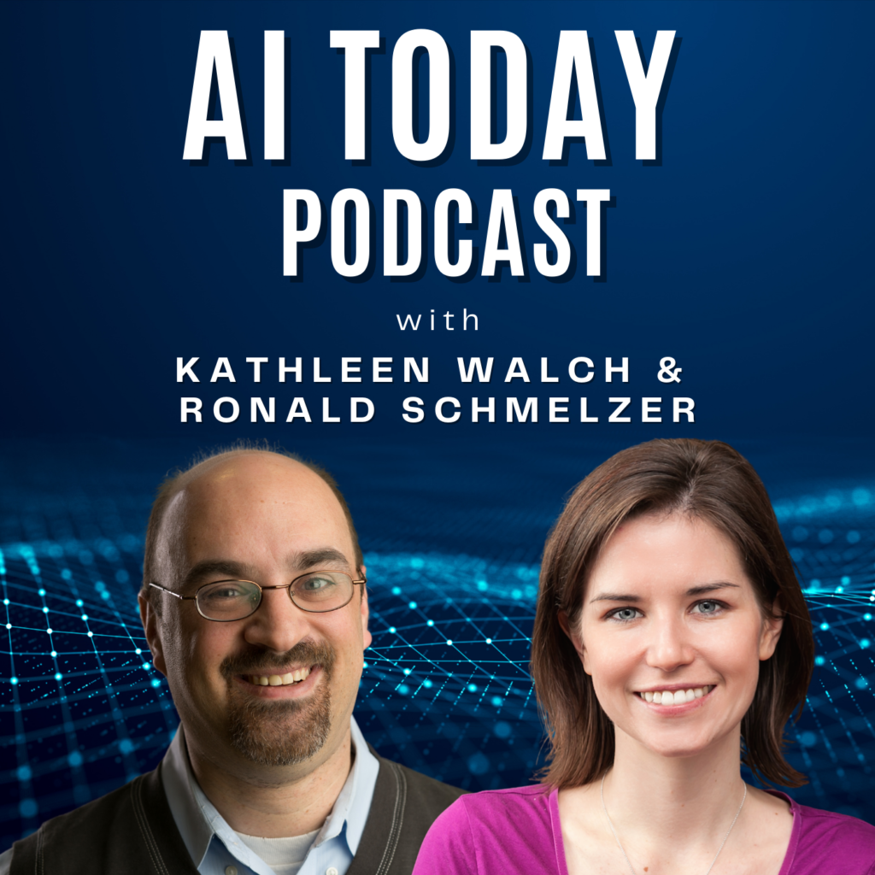



About the Presenters

Slide 4

Cognitive Project Management for AI (CPMAI) Methodology
What is the Cognitive Project Management for AI (CPMAI) Methodology?
Vendor-neutral, data-centric, AI-specific, Iterative methodology for running and managing AI, ML, and cognitive technology projects
CPMAI makes specific enhancements to Agile and CRISP-DM methodologies to meet AI-specific requirements. By extending these methodologies rather than creating a new approach, CPMAI can be implemented in organizations with already-running Agile teams and already-running data organizations.

Slide 5
Part I:
The Fundamentals of AI

Slide 6

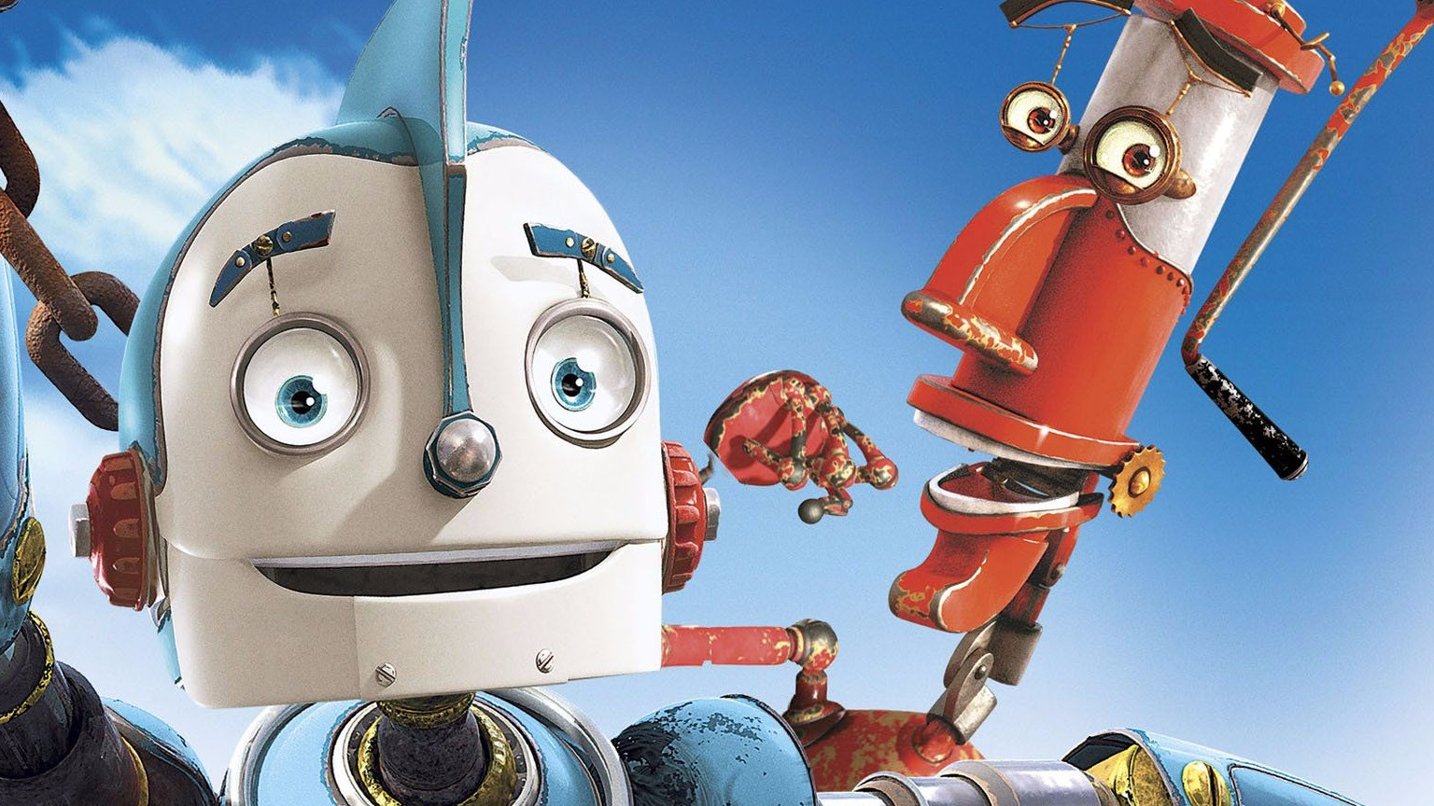

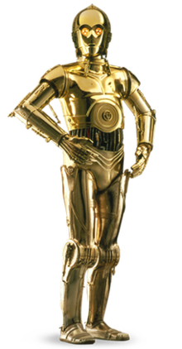
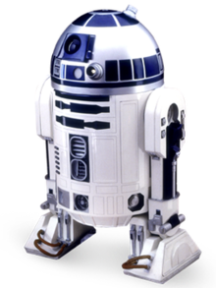
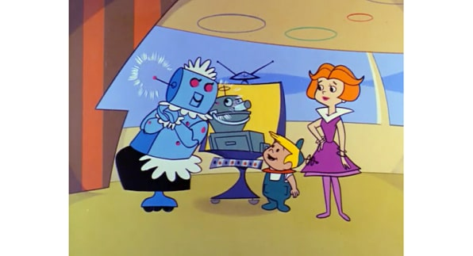
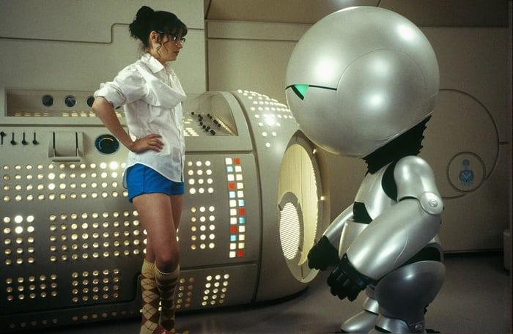
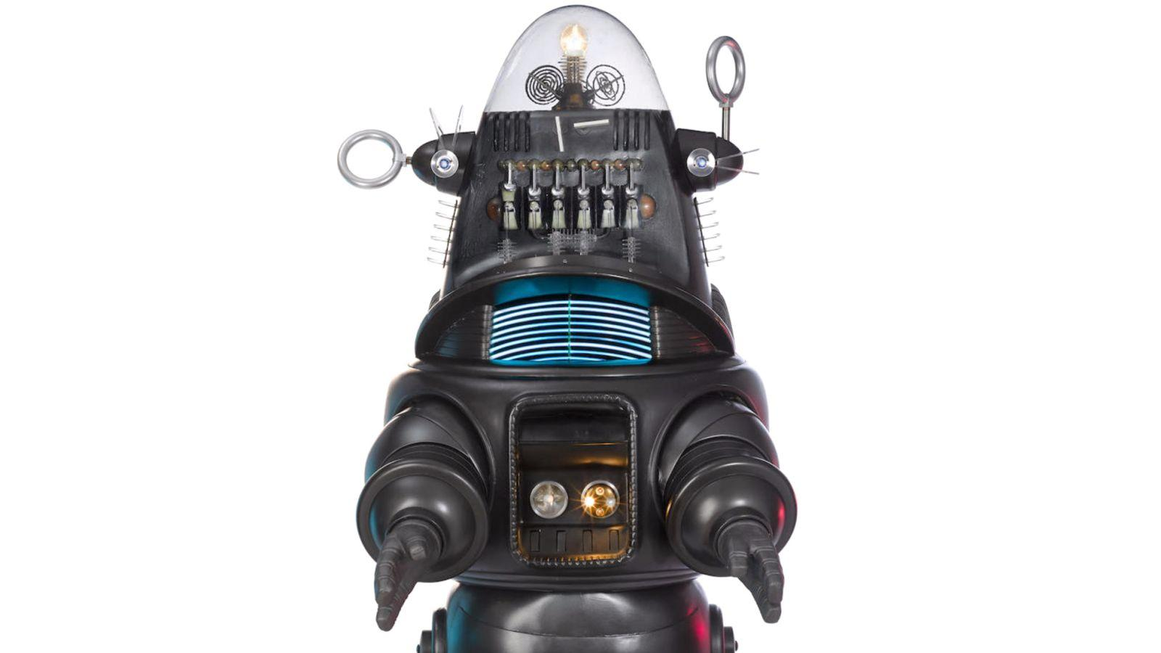

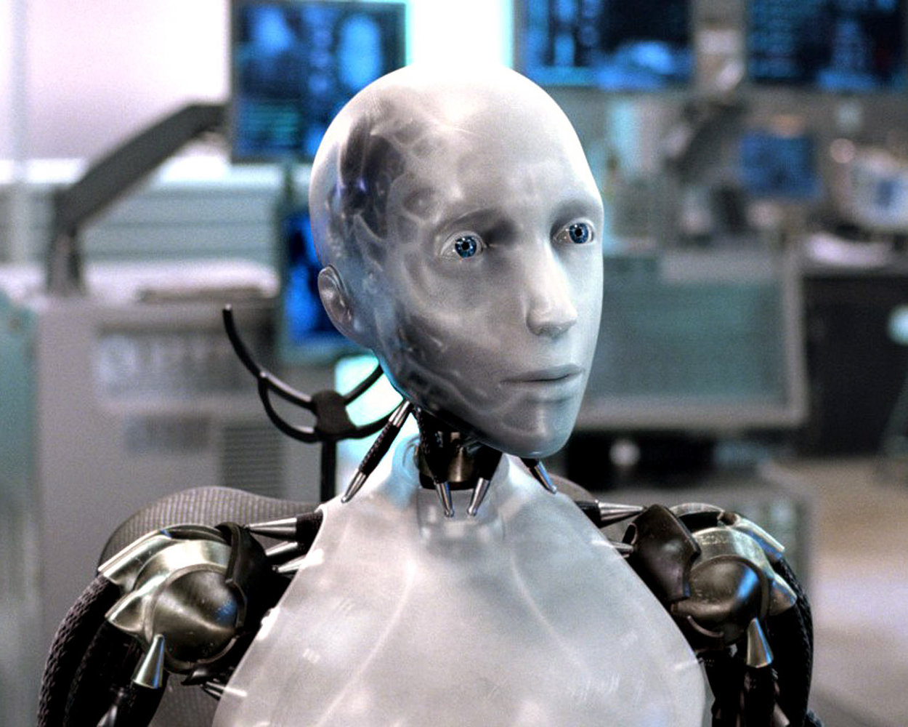

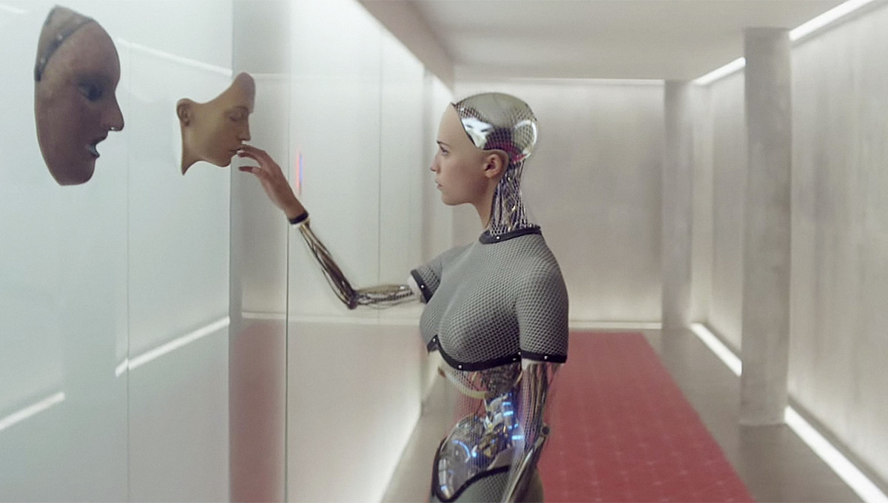

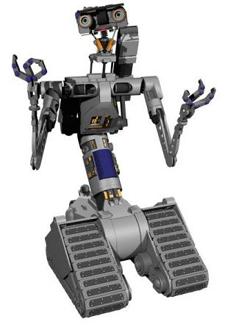
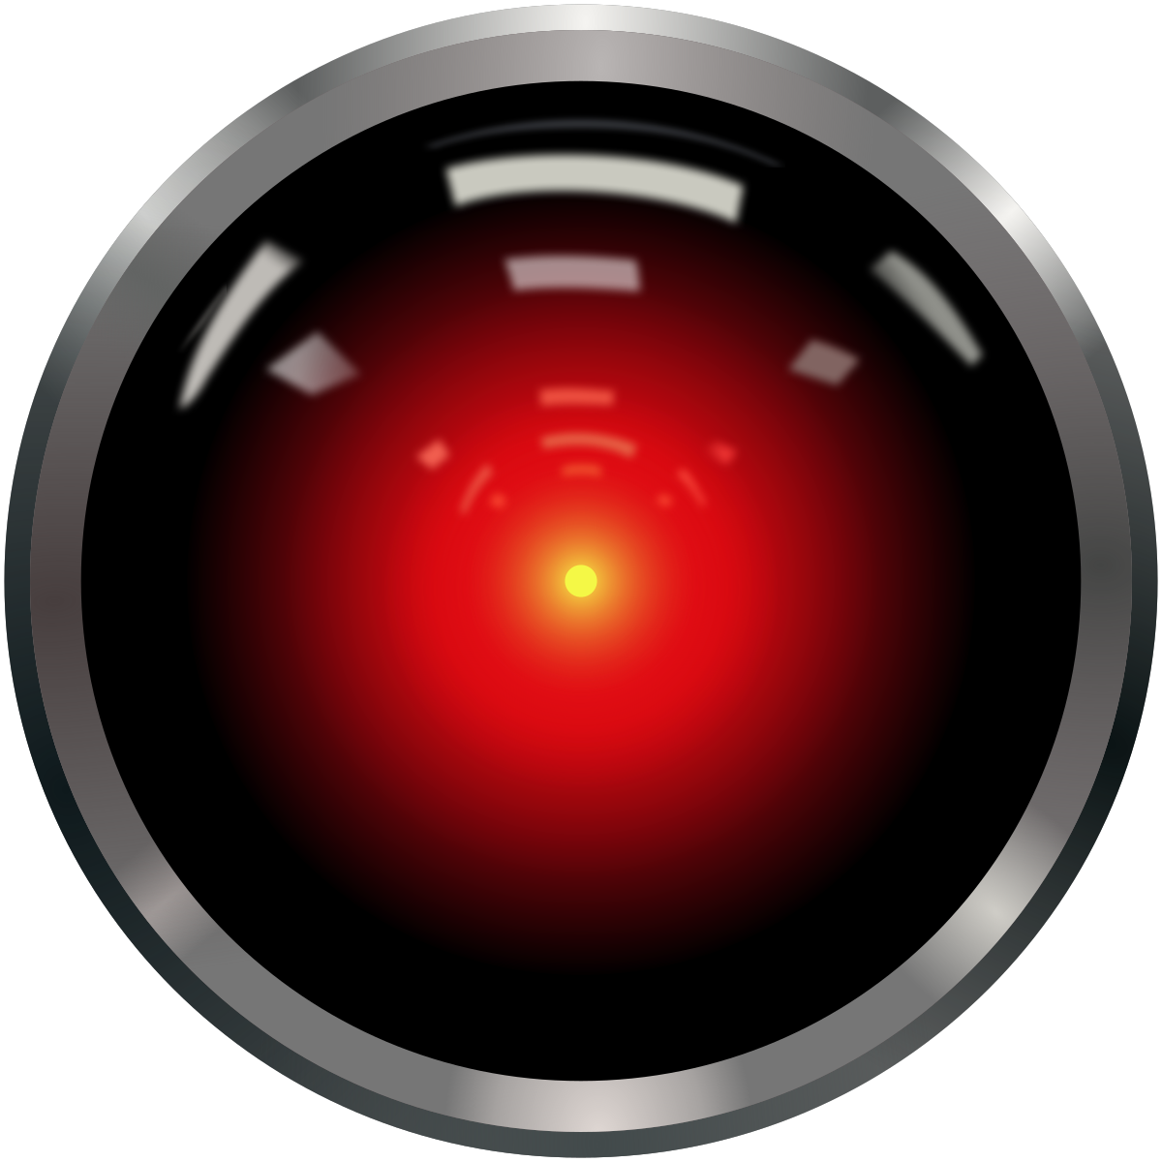
The Dream of the Intelligent Machine

Slide 7
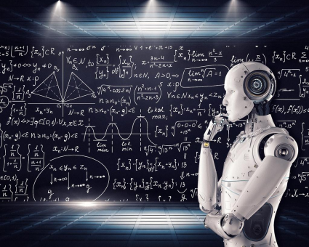
What can we do with an intelligent machine?
Achieving the greater levels of productivity
Improving accuracy
Improving reliability
Eliminating drudgery and dull tasks
Achieving greater scale
Enabling continuous monitoring and auditing
Extracting more value from data
Providing assistance to those in need
The quest of intelligent machines is to understand intelligence. But…what is intelligence?

Slide 8

What is Human Intelligence and why does it matter when it comes to AI?
We’re talking about artificial intelligence, so why do we care about human intelligence?
We can’t create artificial intelligence if we don’t at least try to understand what makes up human intelligence.
So, what are the few core aspects that makes humans intelligent?

Slide 9
What does Human Intelligence consist of?
Perceive and Understand the Outside Environment
Apply learning to different contexts
Understand and Handle Abstract Concepts (Including “Emotions”)
Use that Knowledge to Manipulate One’s Environment
“Goal-directed Future”
Express Creativity and Imagination
Respond Quickly and Successfully Deal with Complex Situations
Discern what is Important from what is Not Important
Handle Ambiguous Situations and Incomplete Information

Slide 10


How can we make Machines Intelligent without knowing how our Brains Work?

Slide 11

We can guess how the brain works…and we can get inspiration
We can think about the ways in which we learn
Through trial and error
Through observing and discovering patterns
Through being taught
mimic the biological structure of the brain
But how does intelligence actually work? We DON’T REALLY KNOW!
All our attempts at making machines intelligent, like humans, will be based on these guesses as to how intelligence works

Slide 12
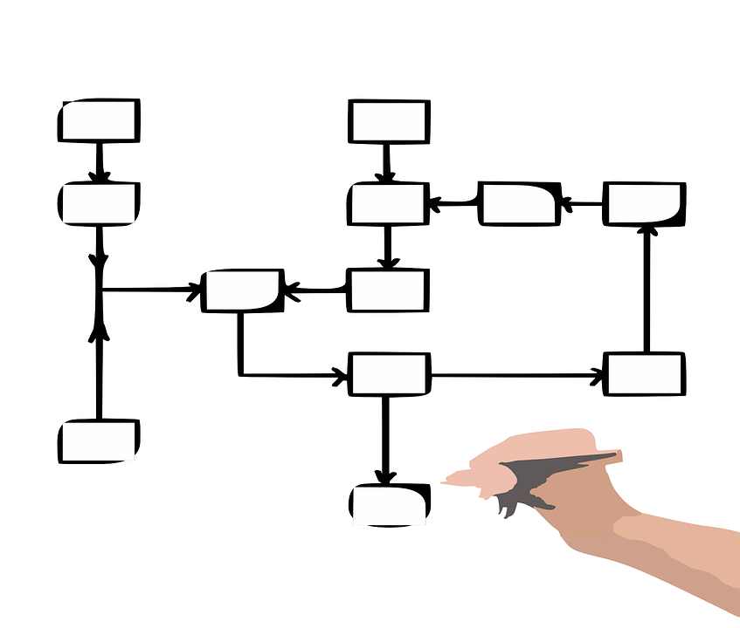


The Core Aspects of Intelligence
Perception
Sensing
Understanding
Processing lots of inputs
Prediction
Understanding possibilities
Thinking Ahead
Planning
Adapting to new environments
Determining outcomes
Self-learning
Feedback loop

Slide 13
Why use AI at All?
Solve problems that can’t be solved with unintelligent, automated systems.
Simple Rules Don’t Work
If you can use simple rules processing or workflow, you should
Requires Object Identification or Classification
You can’t easily program image recognition.
Pattern matching across large quantities of data
Could you build advanced programs without AI to do it? Maybe. ML is easier.
Probabilistic vs. Deterministic Patterns
If behavior doesn’t happen the same way every single time, consider AI.
Advanced Statistics or Analytics is Too Complex
Machine learning does better than non-learning formulas.
Use Cognitive Technologies when you can’t code the rules or you can’t scale easily (with people or automation)

Slide 14
Why Does AI Matter?
We’re in the Always-On, On-Demand, Instant Access Era
People are demanding greater quality of service
People are demanding greater reliability
People are demanding 24/7, instant access
People are demanding more relevance
People are demanding less friction with companies, governments, electronic systems, devices, apps
People want companies, products, systems, and
organizations to be more intelligent

Slide 15

What are common AI myths?
What are common AI myths out there?
Is there any truth to these myths?
Why should you care as you’re on our AI journey?

Slide 16

Busting AI Myths
AI is all about Superintelligent Machines
AI is all about building Robots
AI is all about building Autonomous Vehicles
We don’t need AI, we can just use analytics and statistics
This is just math - nothing special
Automation and Intelligence are the Same Thing
I can’t do AI without a Google-amount of Data
AI, Machine Learning & Deep Learning are all the same thing
I thought neural networks were dead
I can buy AI from a vendor

Slide 17

What are AI & Cognitive Technologies Best Suited For?
Classification & Identification
Conversational Interfaces
Big Data Predictive Analytics
Pattern Discovery
Autonomous Systems
Game & Scenario Playing (“Rules discovery”)
Hyper-Personalization & Recommendation
If it’s probabilistic, use a learning approach

Slide 18

What are AI & Cognitive Technologies not Suited for?
Repetitive, Deterministic Automation Tasks
Formulaic Analytics
Systems that require 100% accuracy
Situations with very little training data
Situations where hiring a person is easier, cheaper, and faster
A need to do “AI” without understanding what it is or what it’s for
If it’s deterministic, use a programming approach

Slide 19
Definitions of Artificial Intelligence
Despite the term being officially coined in 1956, there’s no single, commonly accepted definition of Artificial Intelligence:
“Artificial Intelligence is the science and engineering of making intelligent machines.” -- John McCarthy, AI researcher at Stanford, MIT, and Dartmouth coined the phrase “Artificial Intelligence”
“Artificial Intelligence doesn’t mean [just] one thing… it’s a collection of practices and pieces that people put together.” -- Rodney Brooks, pioneering AI researcher, MIT professor, Rethink Robotics, iRobot (Roomba)
“Artificial intelligence is that activity devoted to making machines intelligent, and intelligence is that quality that enables an entity to function appropriately and with foresight in its environment.” -- Nils J. Nilsson, Stanford University
AI is “intelligence that is not biological.” - Max Tegmark, researcher, MIT professor
AI is “a branch of computer science that studies the properties of intelligence by synthesizing intelligence” -- Herbert A. Simon, pioneering AI researcher, Carnegie Mellon

Slide 20
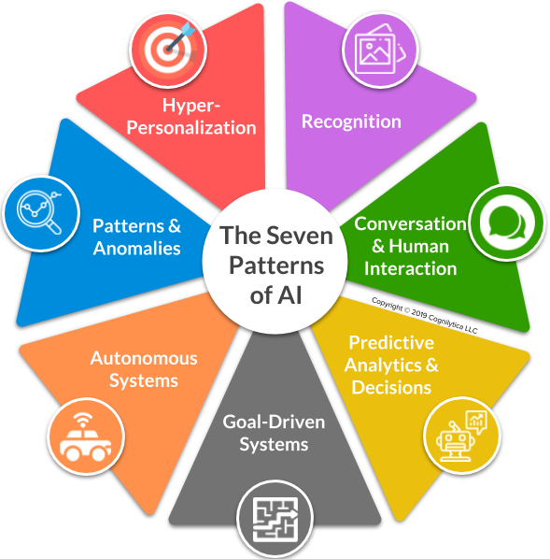
The Seven Patterns of AI
These patterns play a critical role in the OECD’s definition of AI and the AI definition in the EU AI Act.
https://mneguidelines.oecd.org/RBC-and-artificial-intelligence.pdf

Slide 21

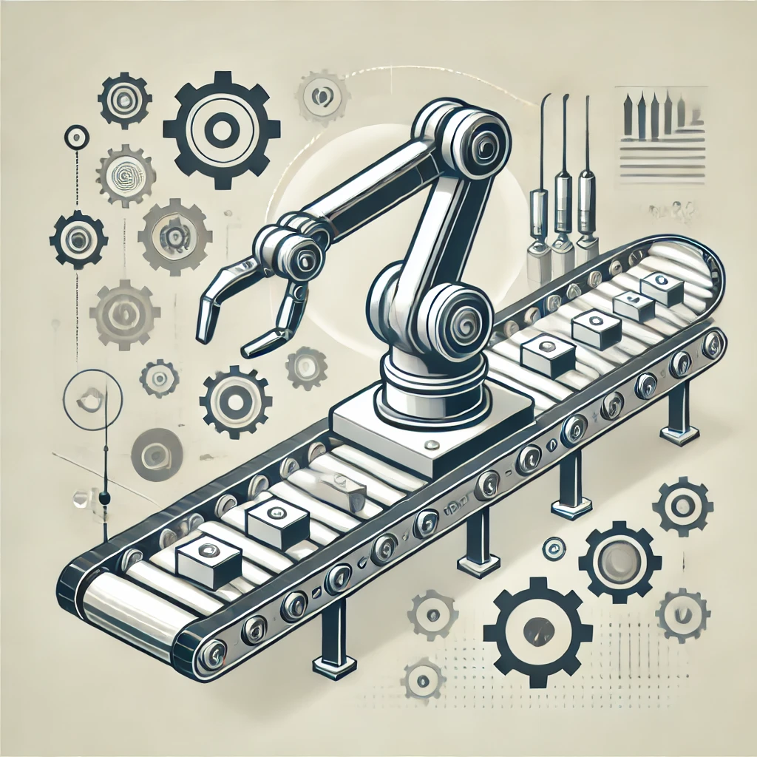
Automation is Not Intelligence
Automating things is just the act of using machines to repeat tasks
Remember the three key aspects of intelligence: Perceive, Predict, Plan
Is there any machine learning in the system?
Can the system improve over time and with experience?
Can the system determine next steps and avoid exceptions without human intervention?
If not, then it’s not intelligent

Slide 22
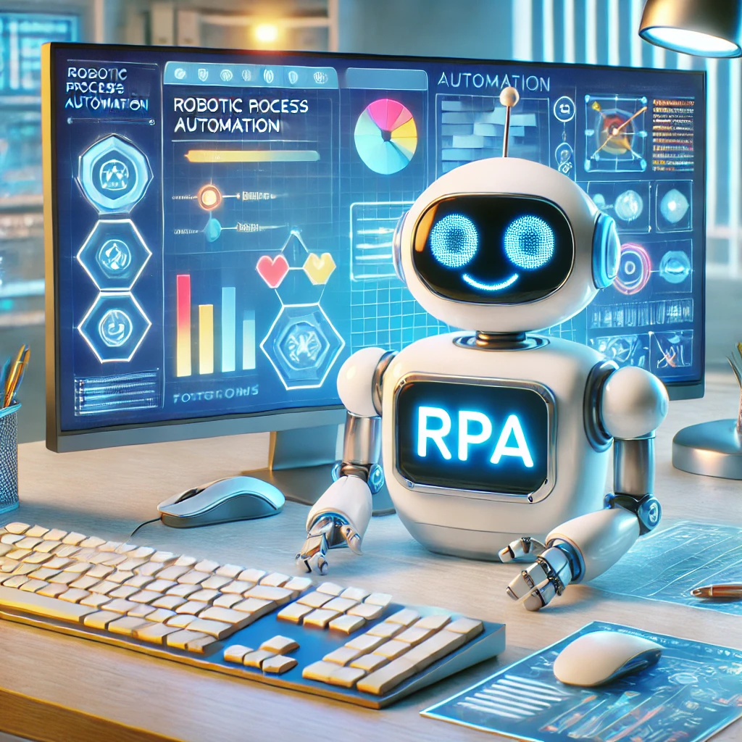
Robotic Process Automation (RPA)
Robotic Process Automation
If you can automate hardware, why can’t you automate software?
Software “bots”
Automate repetitive tasks previously handled by humans
“Swivel-chair” Integration
Repeating User Interface tasks: keyboard, click, swipe, etc.
Solves many problems of system-to-system integration
RPA is an alternate solution to Business Process Outsourcing (BPO) and APIs
We use RPA to take the “robot” out of the human
The only “robots” in RPA are software bots

Slide 23
Artificial General Intelligence (AGI) vs Narrow AI
Artificial General Intelligence (AGI) | Narrow AI
The ability for a machine to handle any cognitive or learning task at human or superhuman levels. Focused on creating intelligent machines that can successfully perform any intellectual task that a human is able to perform without requiring retraining or use of different machine learning models for different tasks. Not fully realized, with some questioning if it will be possible | AI focuses on a single or small set or related learning tasks for a specific function. Narrow AI applications generally have to be retrained, use completely different algorithmic approaches, and different data to be applied to different learning domains or tasks Examples of Narrow AI include: Image recognition Recommendation systems AI powered chatbots Autonomous Systems Remember…7 Patterns of AI

Slide 24


Augmented Intelligence
Humans
Great At:
Intuition
Emotional IQ
Common Sense
Creativity
Poor At:
Probabilistic Thinking
Dealing with large volumes of info
Bias
AI
Great At:
Probabilistic Thinking
Dealing with large volumes of info
Being Trained
Poor At:
Intuition
Emotional IQ
Common Sense
Creativity
Bias
+
=
Augmented
Intelligence

Slide 25
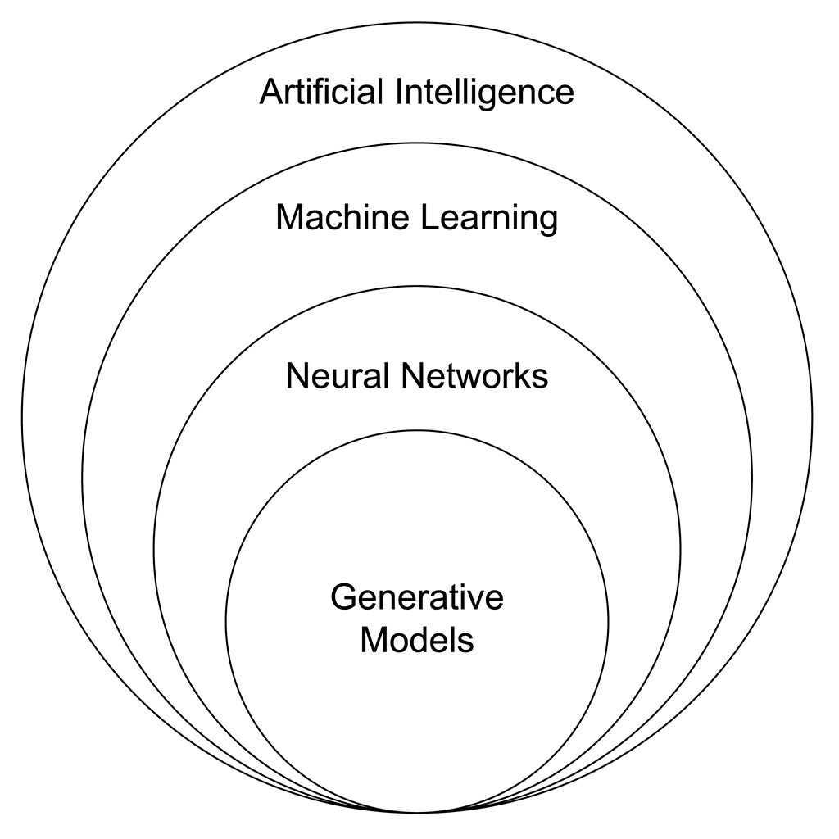
Generative AI
Machine learning systems are good at discovering patterns, either by being trained (supervised), through discovery (unsupervised), or trial and error (reinforcement)
What if we can create new data that is similar to the patterns we have already found?
Generative AI is the application of machine learning techniques to the creation of new data based on learned patterns
Generative AI models are a type of deep learning neural network model
Notes:
For Generative AI, we create machine learning model(s) whose output is the sort of data we’re looking to generate
The generative models are usually specific to the kind of thing you want to generate
Text generators are optimized for text and can’t really generate images
Images generators are optimized for images and can’t really generate text

Slide 26

Generative AI “Hallucination”
GenAI models don’t really “understand” what they are generating
Some more advanced LLMs have better chance of catching falsehoods in data, but all Gen AI models are susceptible to “hallucination”
The Image generation equivalent of hallucination: the “fingers” problem
Notes:
GenAI models are just text prediction models
They are more than capable of predicting text that isn’t really valid or true
What is the the “fingers” problem? misplaced limbs, bad teeth, hair issues, images showing inconsistencies of all sorts

Slide 27
Large Language Models
Large language models (LLMs) are trained deep-learning neural network models that are configured to generate human understandable text from human provided input prompts.
They use very large data sets to understand, summarize, generate and predict new content.
LLMs leverage Transformer models which have proven to be especially powerful for Natural Language Processing applications and image generation, but have shown versatility in a wide range of applications even in use cases for computer vision.
Notes:
Popularized by models such as GPT-4.o, Gemini 2.0, Stable diffusion, DALL-E, transformer models are quickly becoming a preferred model of choice for NLP applications and other uses that require the transformation of one sequence into another
for example, one text sequence such as a prompt, into another text sequence, such as a much longer amount of text, or from a text prompt to an image, and other applications

Slide 28
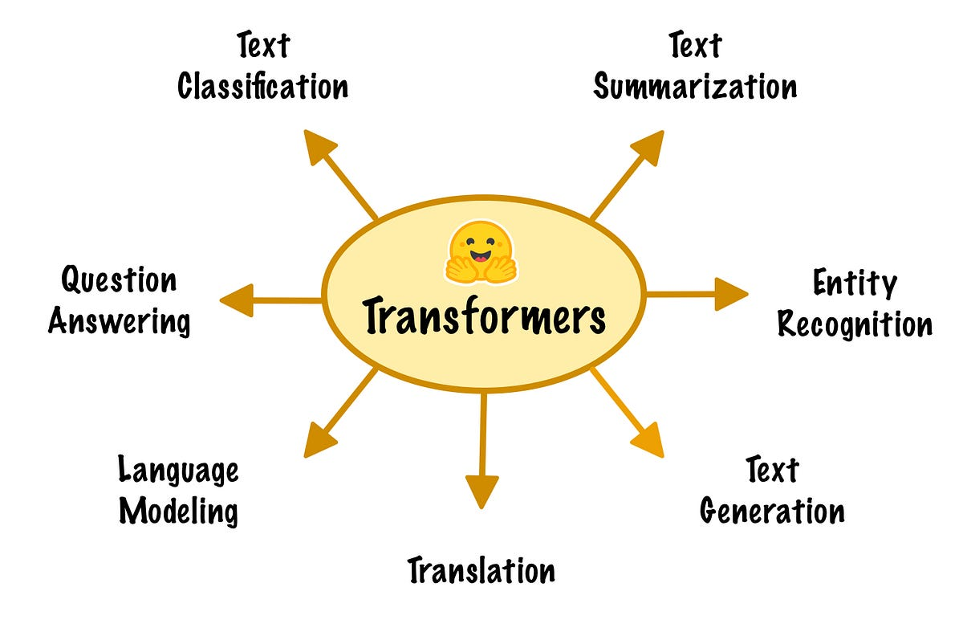
Transformer Models
A type of deep learning model designed for processing sequential data like text, images, or audio.
Utilizes mechanisms like self-attention to understand relationships between elements in a sequence.
Highly effective for tasks such as natural language processing (NLP), image generation, and more.
Known for scalability, versatility, and state-of-the-art performance in various AI applications.

Slide 29

AI is Transformative & Transformation is Disruptive
Artificial Intelligence is transformative
Transformative technologies are also usually very disruptive.
Every major wave of technology that’s transformative has this impact.
Trustworthy AI requires Responsible AI

Slide 30

Disruption can be Good
Improving quality of life
Improving productivity
Enhancing our work, personal, and social experiences
Creating new opportunities to do things that haven’t been done before
New job opportunities and improvements to work
Technology used to improve many world challenges

Slide 31

Disruption can be Problematic
Workforce changes
Societal disruption
The continued decay of privacy
Technology replacing common sense
Introduction of new physical and cyber threats
Every major wave of technology that’s transformative has this impact

Slide 32

Tackling Fears of AI
People have some real fears about AI - not all of these are grounded in truth
Worried AGI will take over the world
Worried robots will take my job
Worried I’ll lose control over all my privacy and data
Too much data in too few hands
Fears are emotional more than rational

Slide 33
Concerns over Artificial General Intelligence (AGI)
The reality: everything we’re doing now are Narrow Applications of AI – we haven’t yet figured out AGI
The “SuperIntelligence”
AGI systems that learn how to learn (“The Singularity”)
Systems that can quickly and iteratively self-improve to the point that we can’t control
Fear of AI systems that run amok
The “Paperclip Optimizer”
Is a 0.000001% risk worth worrying about?
Fear of Companies because we don’t know what they are up to
OpenAI & DeepMind (Google)
What is the real end goal?
Reality Check: Have you talked to Alexa/Siri recently? Yeah, it’s still dumb.

Slide 34
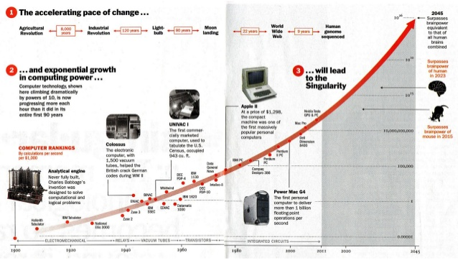

The “Singularity”
“A hypothetical future point in time at which technological growth becomes uncontrollable and irreversible, resulting in unforeseeable changes to human civilization.”
AGI systems that learn how to learn
Systems that can quickly and iteratively self-improve to the point that we can’t control
Notes:
Popularized by Vernor Vinge in a 1983 article and then in a 1993 essay "The Coming Technological Singularity.
Expanded by Ray Kurzweil in “The Singularity is Near” (2005), predicting singularity by 2045
“During the singularity, Kurzweil predicts that "human life will be irreversibly transformed" and that humans will transcend the "limitations of our biological bodies and brain"
A major theme in AI fears

Slide 35

Tackling Real Concerns of AI
People have some real concerns about AI as well - these are grounded in facts
Lack of transparency (esp around deep learning)
Bad actors doing bad things with AI
AI systems vulnerable to tampering and data security
Susceptible to bias in data and issues of fairness
Concerns around data privacy and usage
Laws not keeping up with technology
Concerns are fact-based realities that must be dealt with

Slide 36
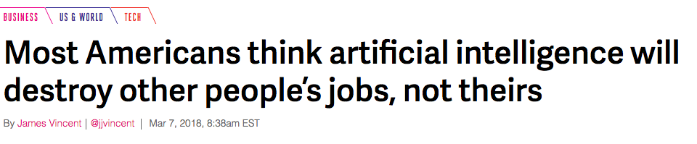
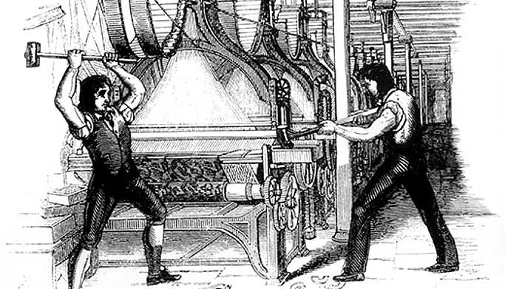
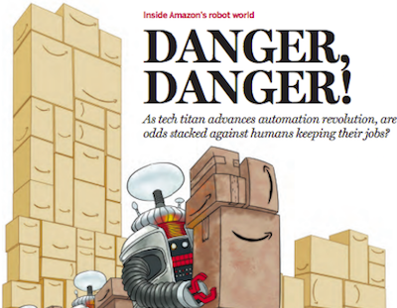
Will AI Systems Replace Human Workers?
A constant concern of technology is that it replaces human labor
The problem is that it’s economically disrupting
AI is not a Job Killer, but it is a Job Category Killer
Classes of jobs will most likely disappear
Business Process Outsourcing looks like a low/no-growth industry
Customer service jobs most likely impacted
Continued change of retail
Classes of jobs will most definitely appear
Who knew 15 years ago we’d have Social Media Marketers?
Data Science and Related areas
Intelligent Robotics
Augmented Intelligence vs. Artificial Intelligence

Slide 37

Automation and the Amazon Paradox
People fear that automation will take away jobs
Amazon heavily uses robots
Amazon’s curious paradox
“Amazon has added 80,000 warehouse employees in the United States since adding the Kiva robots, for a total of more than 125,000 warehouse employees. And it says the warehouse hiring spree will continue.” - https://www.nytimes.com/2017/09/10/technology/amazon-robots-workers.html
Since introducing robotics in 2012, they have added tens of thousands of robots to their fulfillment centers while they also added more than 300,000 full-time workers globally
Humans still needed for many tasks including picking items, “last mile” delivery

Slide 38

Team Interaction: AI Fear and Concern Fact-Checker
70 min.
Help participants identify common fears and concerns about AI, understand the root causes, and collaboratively discuss evidence-based ways to address them.
Step 1: Identify AI Fears and Concerns that occur at your organization (30 minutes)
Explore the realities behind fears and concerns and develop solutions collaboratively.
Why do these fears and concerns exist?
What’s the root cause—e.g., lack of knowledge, media exaggeration?
What’s the reality? (Are the concerns valid? Provide evidence or examples.)
How can we address this fear? (Practical steps, education, or policy changes.)
Groups write their answers on a flip chart or shared digital workspace.
Step 2: Rapid Presentations (30 minutes)
Each team of 7 (10 teams total) will have 3 minutes to share insights and solutions with the larger group.
Step 3:Wrap-Up and Takeaways (10 Minutes)
Reinforce key lessons and provide practical guidance.

Slide 39
Part II:
Applications & Return on Investment (ROI) of AI

Slide 40
The Seven Patterns of AI

Slide 41


Conversation & Human Interaction Pattern
The objective of this pattern is machines interacting with humans the way humans interact with each other

Slide 42
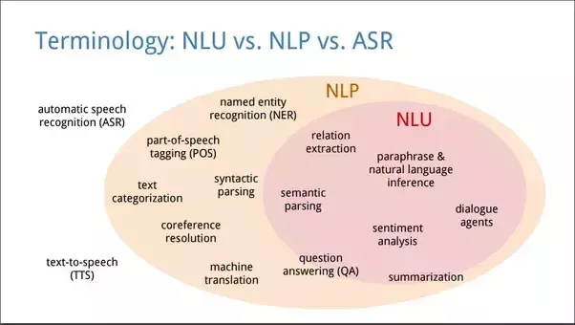
Conversation & Human Interaction Pattern
Natural Language Processing (NLP)
A field of computer science that applies AI to the challenge of getting machines to understand and communicate using the language of humans.
Natural Language Generation (NLG)
The use of AI systems to create written or spoken text in language that a human can understand.
Natural Language Understanding (NLU)
The use of AI systems to enable machines to understand written or spoken human language.
Notes:
Examples
Text-to-speech is a form of NLG (Generation)
Speech-to-text is a form of NLU (Understanding)

Slide 43
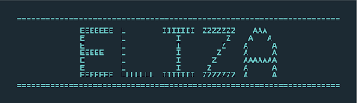

Chatbots & Conversational Interfaces
First real conversational chatbot was ELIZA in 1966
Text or Voice
“Conversational Computing”
Sometimes, people like to talk and not to click and swipe!
Use Cases
Customer Support & Engagement
Assistant-Enabled Commerce
Intelligent Voice Assistants

Slide 44
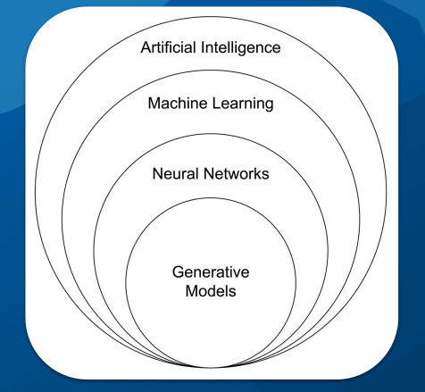
Generative AI
Machine learning systems are good at discovering patterns, either by being trained (supervised), through discovery (unsupervised), or trial and error (reinforcement)
Generative AI is the application of machine learning techniques to the creation of new data based on learned patterns
Generative AI models are a type of deep learning neural network model
For Generative AI, we create machine learning model(s) whose output is the sort of data we’re looking to generate
Notes:
The generative models are usually specific to the kind of thing you want to generate
Text generators are optimized for text and can’t really generate images
Images generators are optimized for images and can’t really generate text

Slide 45

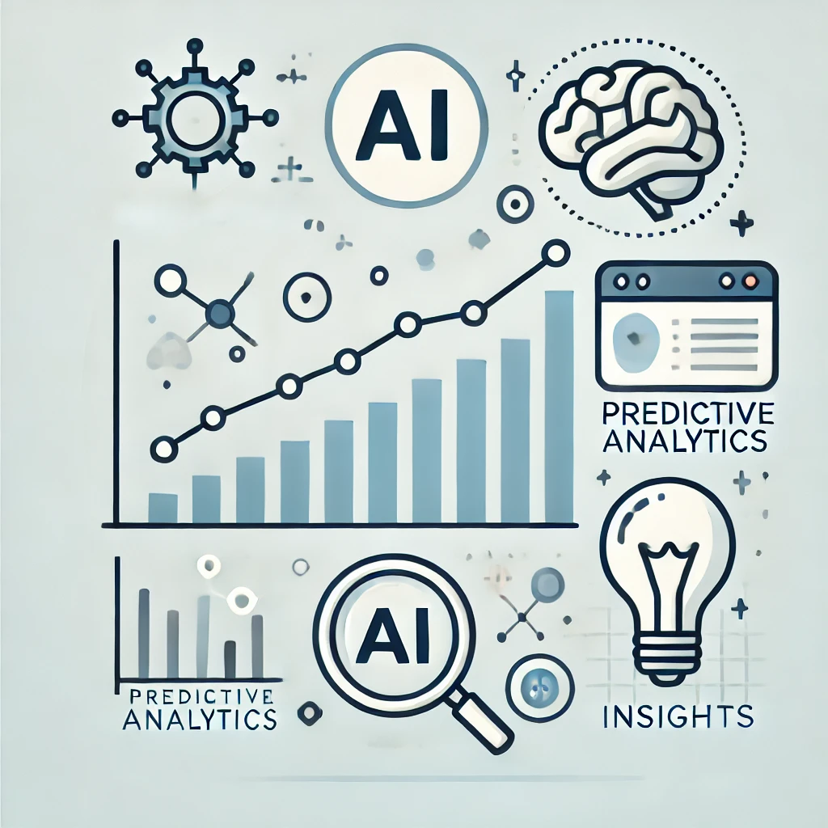
Predictive Analytics & Decision Support Pattern
The objective of this pattern is helping humans make better decisions

Slide 46
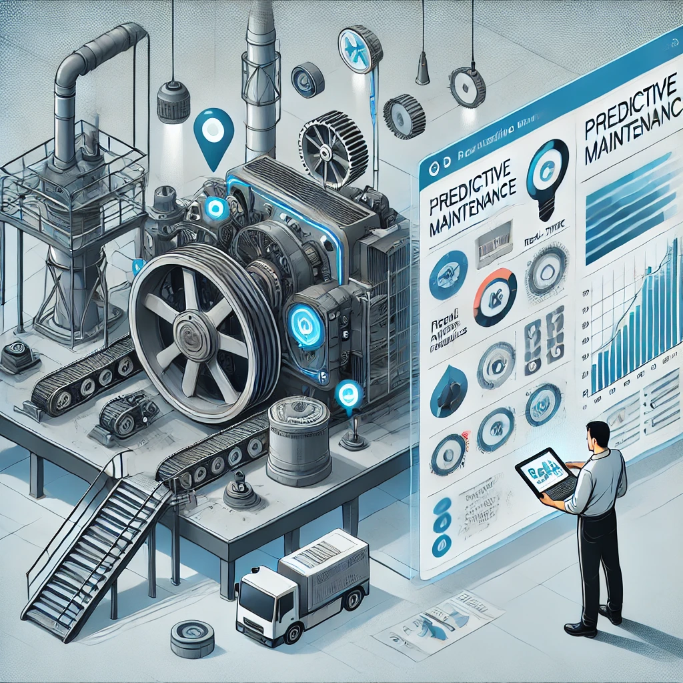
Predictive Analytics Examples
Assisted search and retrieval
Forecasting
Supply chain forecasting
Weather forecasting
Predicting a number or a value
Dynamic / Predictive Pricing
Predicting behavior
Predicting failure
Predictive Maintenance
Identifying and selecting “best fit”
Optimization activities
Situational awareness

Slide 47


Goal Driven Systems Pattern
The objective of this pattern is to find the optimal solution to a problem, often through trial and error or game-playing

Slide 48
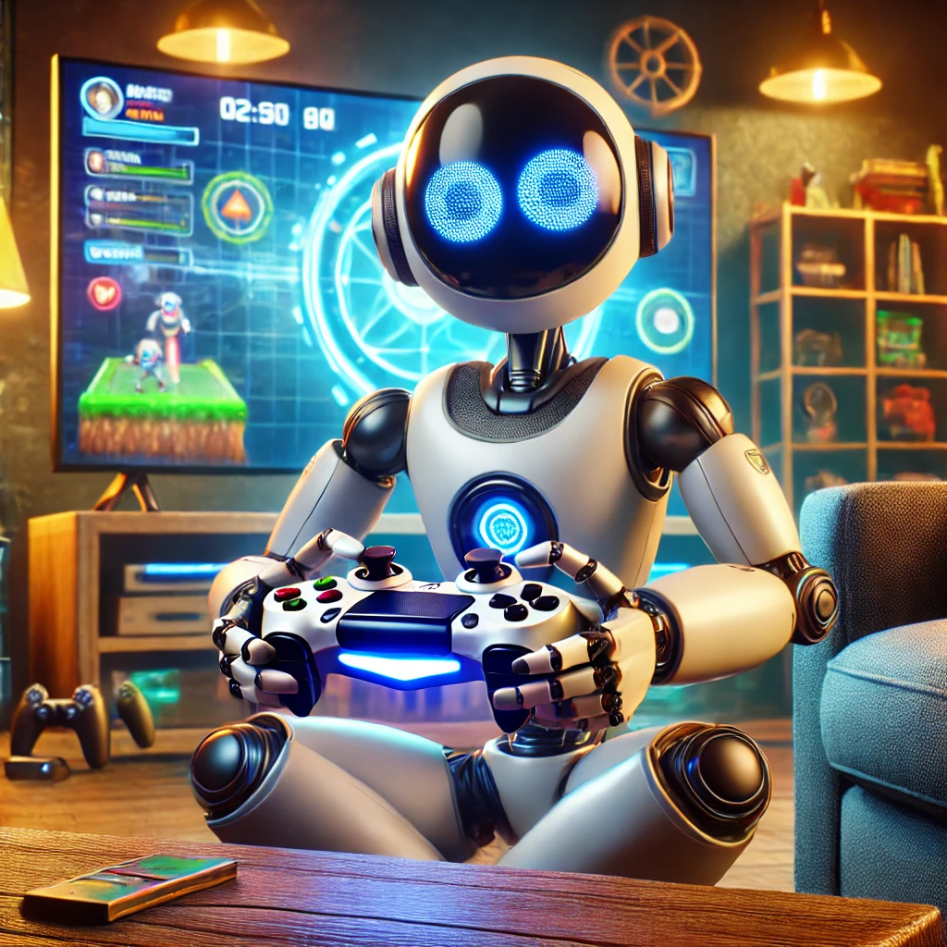
Goal Driven Systems Examples
Examples:
Game Playing
Iterative problem solving
Robo-advising
Bidding and real-time auctions
Robo advising
Real time bidding for ads
Resource optimization (money, equipment, time, other resources)
Anything where you need to figure out best outcome by running lots of simulations

Slide 49

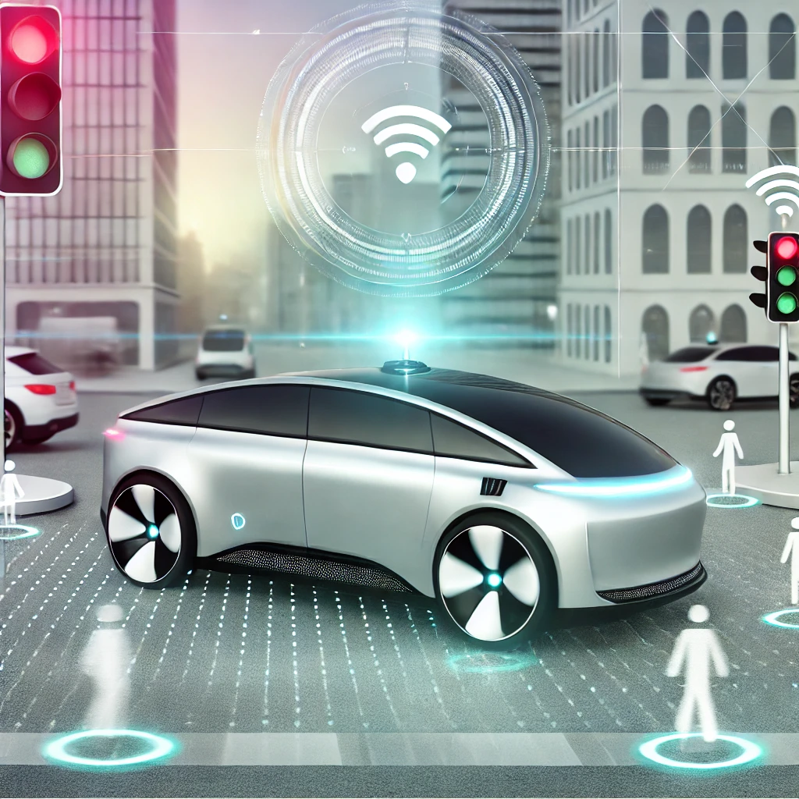
Autonomous Systems Pattern
Physical and virtual (software) systems that are able to accomplish a task, achieve a goal, interact with their surroundings
The objective of this pattern is Minimizing human labor

Slide 50
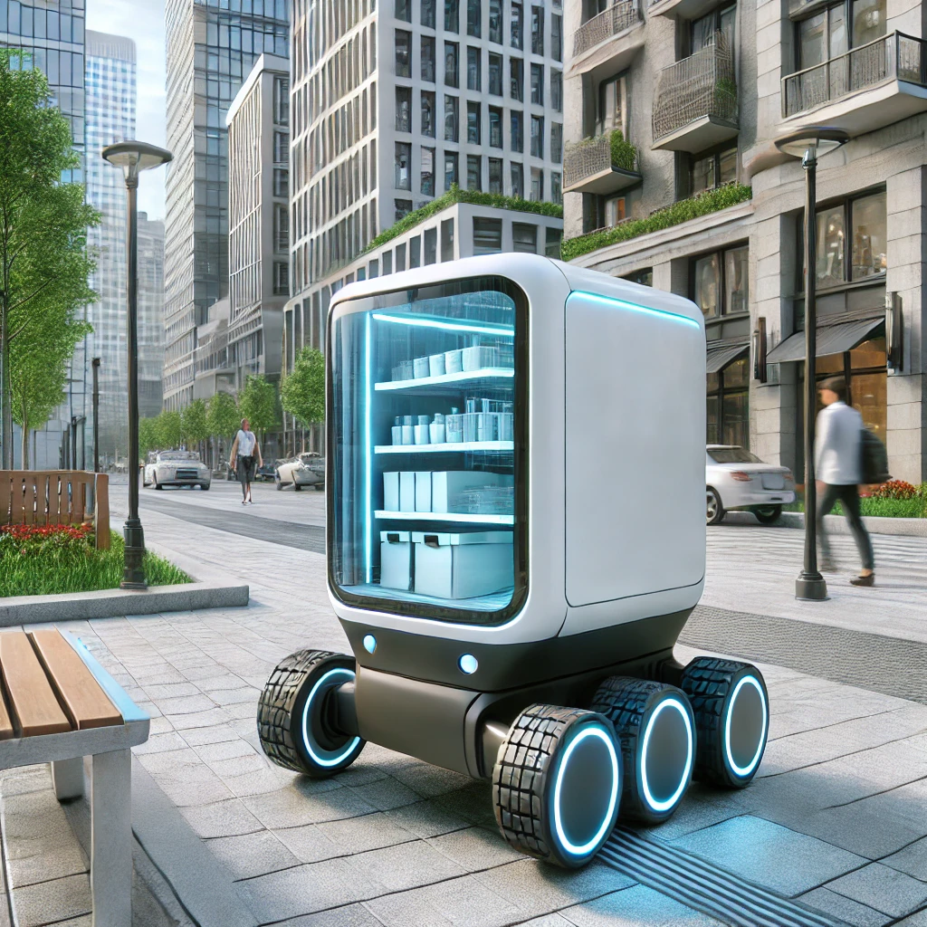
Autonomous Systems Pattern Examples
Autonomous vehicles
Autonomous robots / machines
Autonomous software systems
Autonomous Business Process
Autonomous decision making

Slide 51
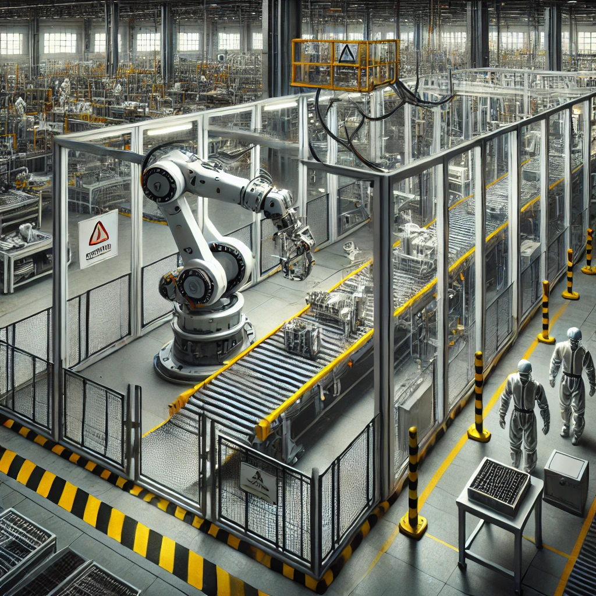
Reminder: Automation is Not Intelligence…
Automating things is just the act of using machines to repeat tasks for predictability
Autonomous systems need to handle variability

Slide 52


Patterns and Anomalies
Machine learning is good at recognizing patterns
If you can train it, you can detect patterns… or things that don’t fit patterns

Slide 53

Patterns and Anomaly Detection Examples
A wide range of use cases
Fraud Detection and Analysis
Finding outliers / anomalies in big stacks of data
Semantic Recommendations
Content Summarization / Text Analysis
Internet of Things (IoT) analytics and flaw detection
Recommendation engines
Sentiment Analysis
Cybersecurity applications
Predictive analytics, especially with Time Series Data

Slide 54
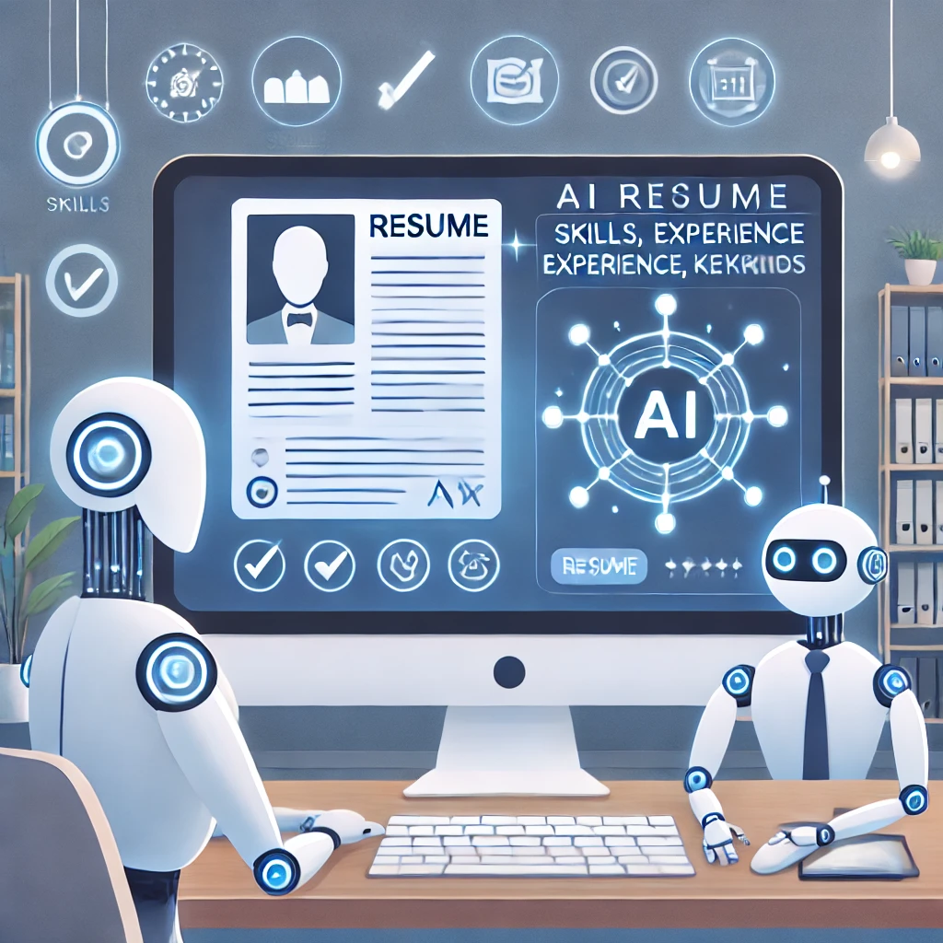
HR Applications: Candidate Matching
AI can create high quality job post for recruiter through the data and predictive analytics
AI can be used to screen candidates and select the best person with reduced bias and discrimination that humans occasionally do.
AI can sort through thousands of potential candidates and reach out in a personalized way to start a conversation. Using AI and machine learning can also help unearth candidates missed by traditional recruiting methods.
AI can find more complete profilings of candidates than human recruiters.

Slide 55


Hyperpersonalization Pattern
The Objective of this pattern is Treating each Individual as an Individual

Slide 56

Hyperpersonalization Examples
Example applications include:
Personalized content
Personalized Recommendations
Behavior profiling
Personalized medicine
Personalized finance
Personalized education
Optimized government services

Slide 57



Recognition Pattern
The objective of this pattern is to have machines understand the real world and unstructured data

Slide 58

Recognition Pattern Examples
Example Applications Include:
Autonomous Vehicles
Security / Surveillance
Facial biometric access
Advertising - Logo recognition
Augmented Reality (AR) enhancement
Automatic image tagging and classification
Autonomous Retail
Interactive Marketing
Facial Recognition

Slide 59
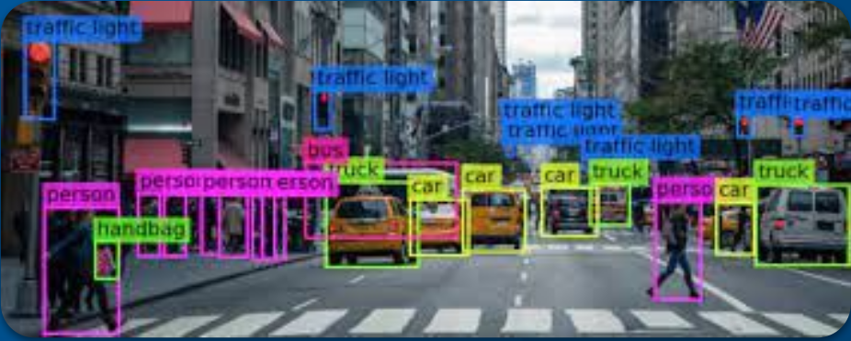
Computer Vision
An application of machine learning or other approaches that provides the ability for computers to interpret and understand visual inputs.
This is one aspect of the recognition pattern of AI that makes sense of unstructured data such as images.
Components of computer vision include image acquisition, image processing, image analysis, object detection, object recognition, image segmentation, scene reconstruction, event detection, object tracking in video, pose estimation, image indexing and search, motion estimation, 3D scene modeling, and image restoration.

Slide 60
Seven Patterns Quiz
10 min.
Guess which pattern(s) of AI these real-world examples are using

Slide 61
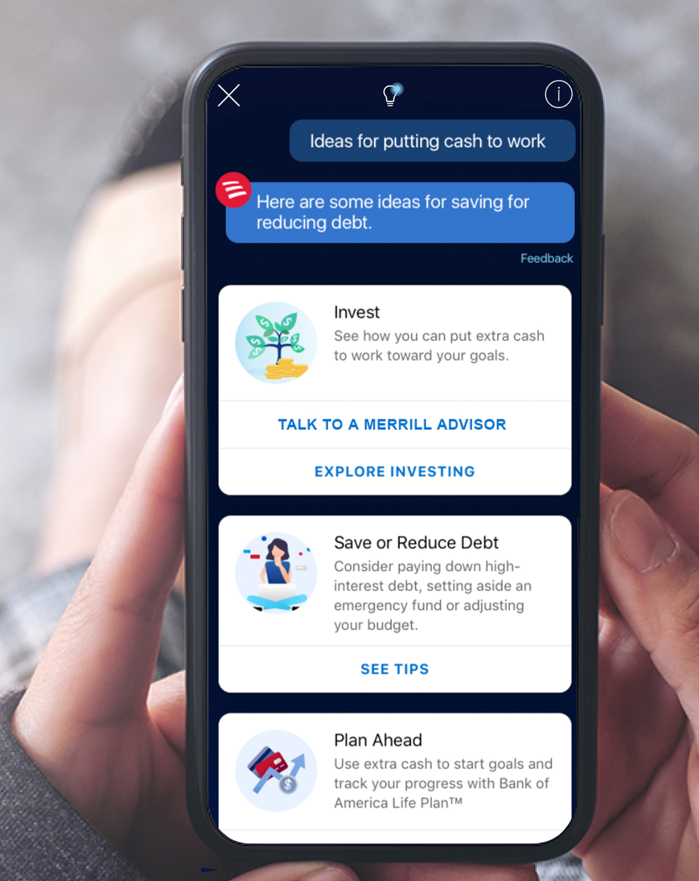
Real-World Applications: Virtual Assistant - Guess the pattern(s)
Erica by Bank of America is a virtual financial assistant integrated into the bank's mobile app. The chatbot can help users with a variety of things including:
Spending Analysis
Provide insights into individual spending habits and monthly spending trends
Account Management
helps users locate specific transactions and provides instant updates on account balances
Bill Payment Assistance
Reminds users of upcoming bills and due dates, automate payments, and tracks past and pending bill payments
Personalized Alerts and Guidance
Helps users set and track savings goals, Sends real-time notifications for unusual activity.

Slide 62

Real-World Applications: Airport Security Assistance - Guess the pattern(s)
The Transportation Security Administration (TSA) began testing facial recognition technology to help with the identity and boarding pass verification process at the checkpoint.
TSA, in collaboration with U.S. Customs and Border Protection has tested AI systems in different airports around the United States to help confirm the identity of travelers

Slide 63

Real-World Applications: Traffic Light Control - Guess the pattern(s)
The City of Pittsburgh, PA wanted to use AI to help find optimal Traffic Light Control
How it works:
The system monitors the volume of traffic approaching each intersection in real time through cameras and radars.
Each stretch of road is split into zones, and the time it takes for vehicles to pass through each one is monitored.
With the help of AI the system calculates variations in traffic flow throughout the approach to each intersection and predict how the traffic will flow. This aggregated picture of traffic is used to calculate light sequencing plans.

Slide 64
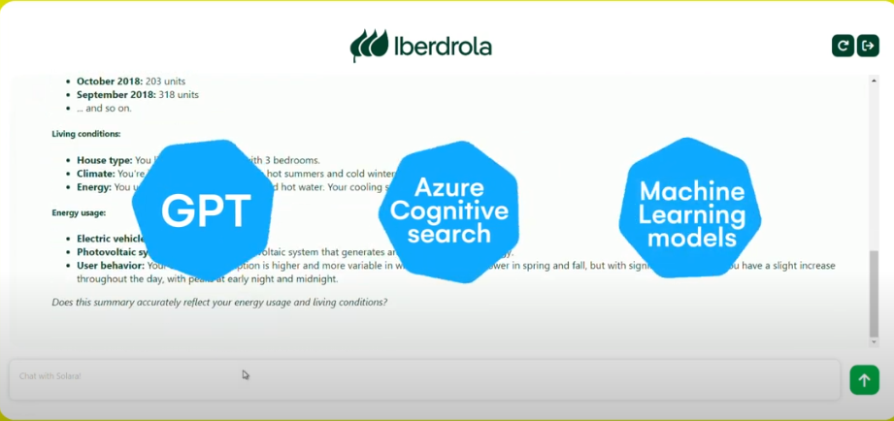
Real-World Applications: Chatbot - Guess the pattern(s)
Iberdrola Middle East, one of the world’s largest energy companies, developed a Generative AI Chatbot tailored for Customer Services serving Iberdrola clients.
The Chatbot needed to provide personalized recommendations based on the user’s profile, requiring the analysis of extensive datasets to deliver accurate and helpful suggestions.
This endeavor involved overcoming technical complexities in understanding diverse customer needs, integrating with existing databases, and training machine learning models to support nuanced interactions that can lead to enhanced customer satisfaction.
Technologies: OpenAI GPT, Azure Cognitive Search, Machine Learning
Source:https://www.bravent.net/en/success-stories/iberdrola-generative-ai-chatbot

Slide 65

Real-World Applications: Billing Portal - Guess the pattern(s)
Juniper Networks, is a large multinational corporation
Their Global Business Services (GBS) group was challenged to find innovative ways to cut costs and add value.
They used unattended RPA bots to automate all non-value-added manual work within internal operations (particularly finance) tp drive efficiency and productivity.

Slide 66


Real-World Applications: Guess the pattern(s)
Intelligent Voice Assistants
Product Recommendation System
Food Delivery Bot

Slide 67

Determining Business Centric ROI
When it comes to determining return on investment (ROI) for your project - Don’t start with the pattern.
First identify the objective you’re trying to solve or the ROI you desire and then use that to figure out that correct pattern - work your way backwards.
This ensures that you’re picking the best pattern for your ROI needs.

Slide 68
The Seven Patterns of AI Guide on Business-centric ROI
Pattern | Objective | Business ROI
 | Improving the fit between a service, product, or offering to each individual user, customer, citizen, patient, etc. | Improve usage, increase conversion, greater satisfaction & relevance
 | Providing natural language interaction between machines and people | User self-service, cost reduction, 24/7 service, improved resolution
 | Systems that can operate independent of human operation | Reduce labor cost, user self-service, 24/7 service, increase reliability
 | Helping humans make better decisions | increase reliability, decrease costs, better quality insights, risk reduction, better quality decisions
 | Identify which things are like others and which aren’t. | increase reliability, decrease costs, better quality insights, risk reduction, improved reliability
 | Identify and understand the real world & unstructured data | increase reliability, decrease costs, reduce labor costs, enhance services, reduce risk
 | Systems that try to find the optimal solution to a problem | Optimize operations, reduce costs, achieve competitive advantages

Slide 69

Short time to ROI: Augmented Intelligence
Augmented Intelligence helps human ability to perform tasks faster or with more precision or accuracy.
Decisions, at the end of the day, are still made by humans.
We’re not replacing a human we’re just helping a human perform a task or function better/faster/more accurately
Examples of Augmented Intelligence include:
Spam Filters
Semi-autonomous features of cars
Medical Diagnosis Support
Customer Service Assistance
Creative Content Assistance
AI provides grammar corrections, tone suggestions, and content ideas

Slide 70
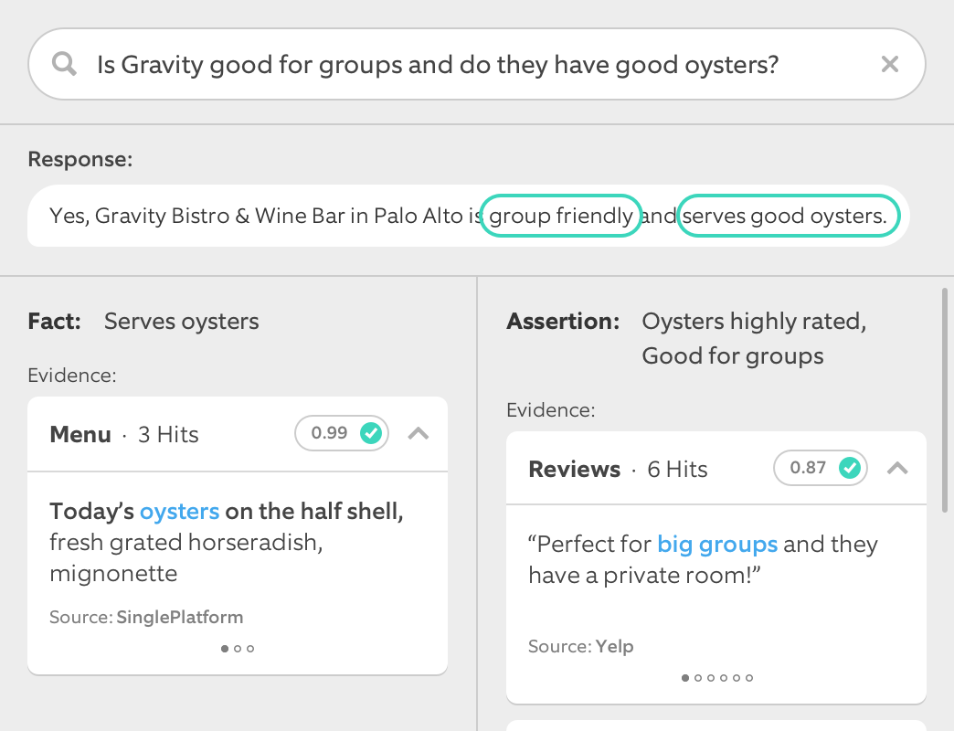
Short time to ROI: Conversational Systems
Chatbots and voice assistants can provide immediate ROI
Replacing documents and online help with immediate answers to questions
Using conversational agents to provide 24/7 customer support
Chatbots also can facilitate sales and marketing activities
Voice assistants provide instant access to information
Reduce call center load
Increase customer engagement
Improve cross-sell and up-sell of products
Improve customer satisfaction
The tooling to enable broad adoption of conversational patterns of AI is very mature. This is a low-risk, high-return pattern for short-term ROI

Slide 71
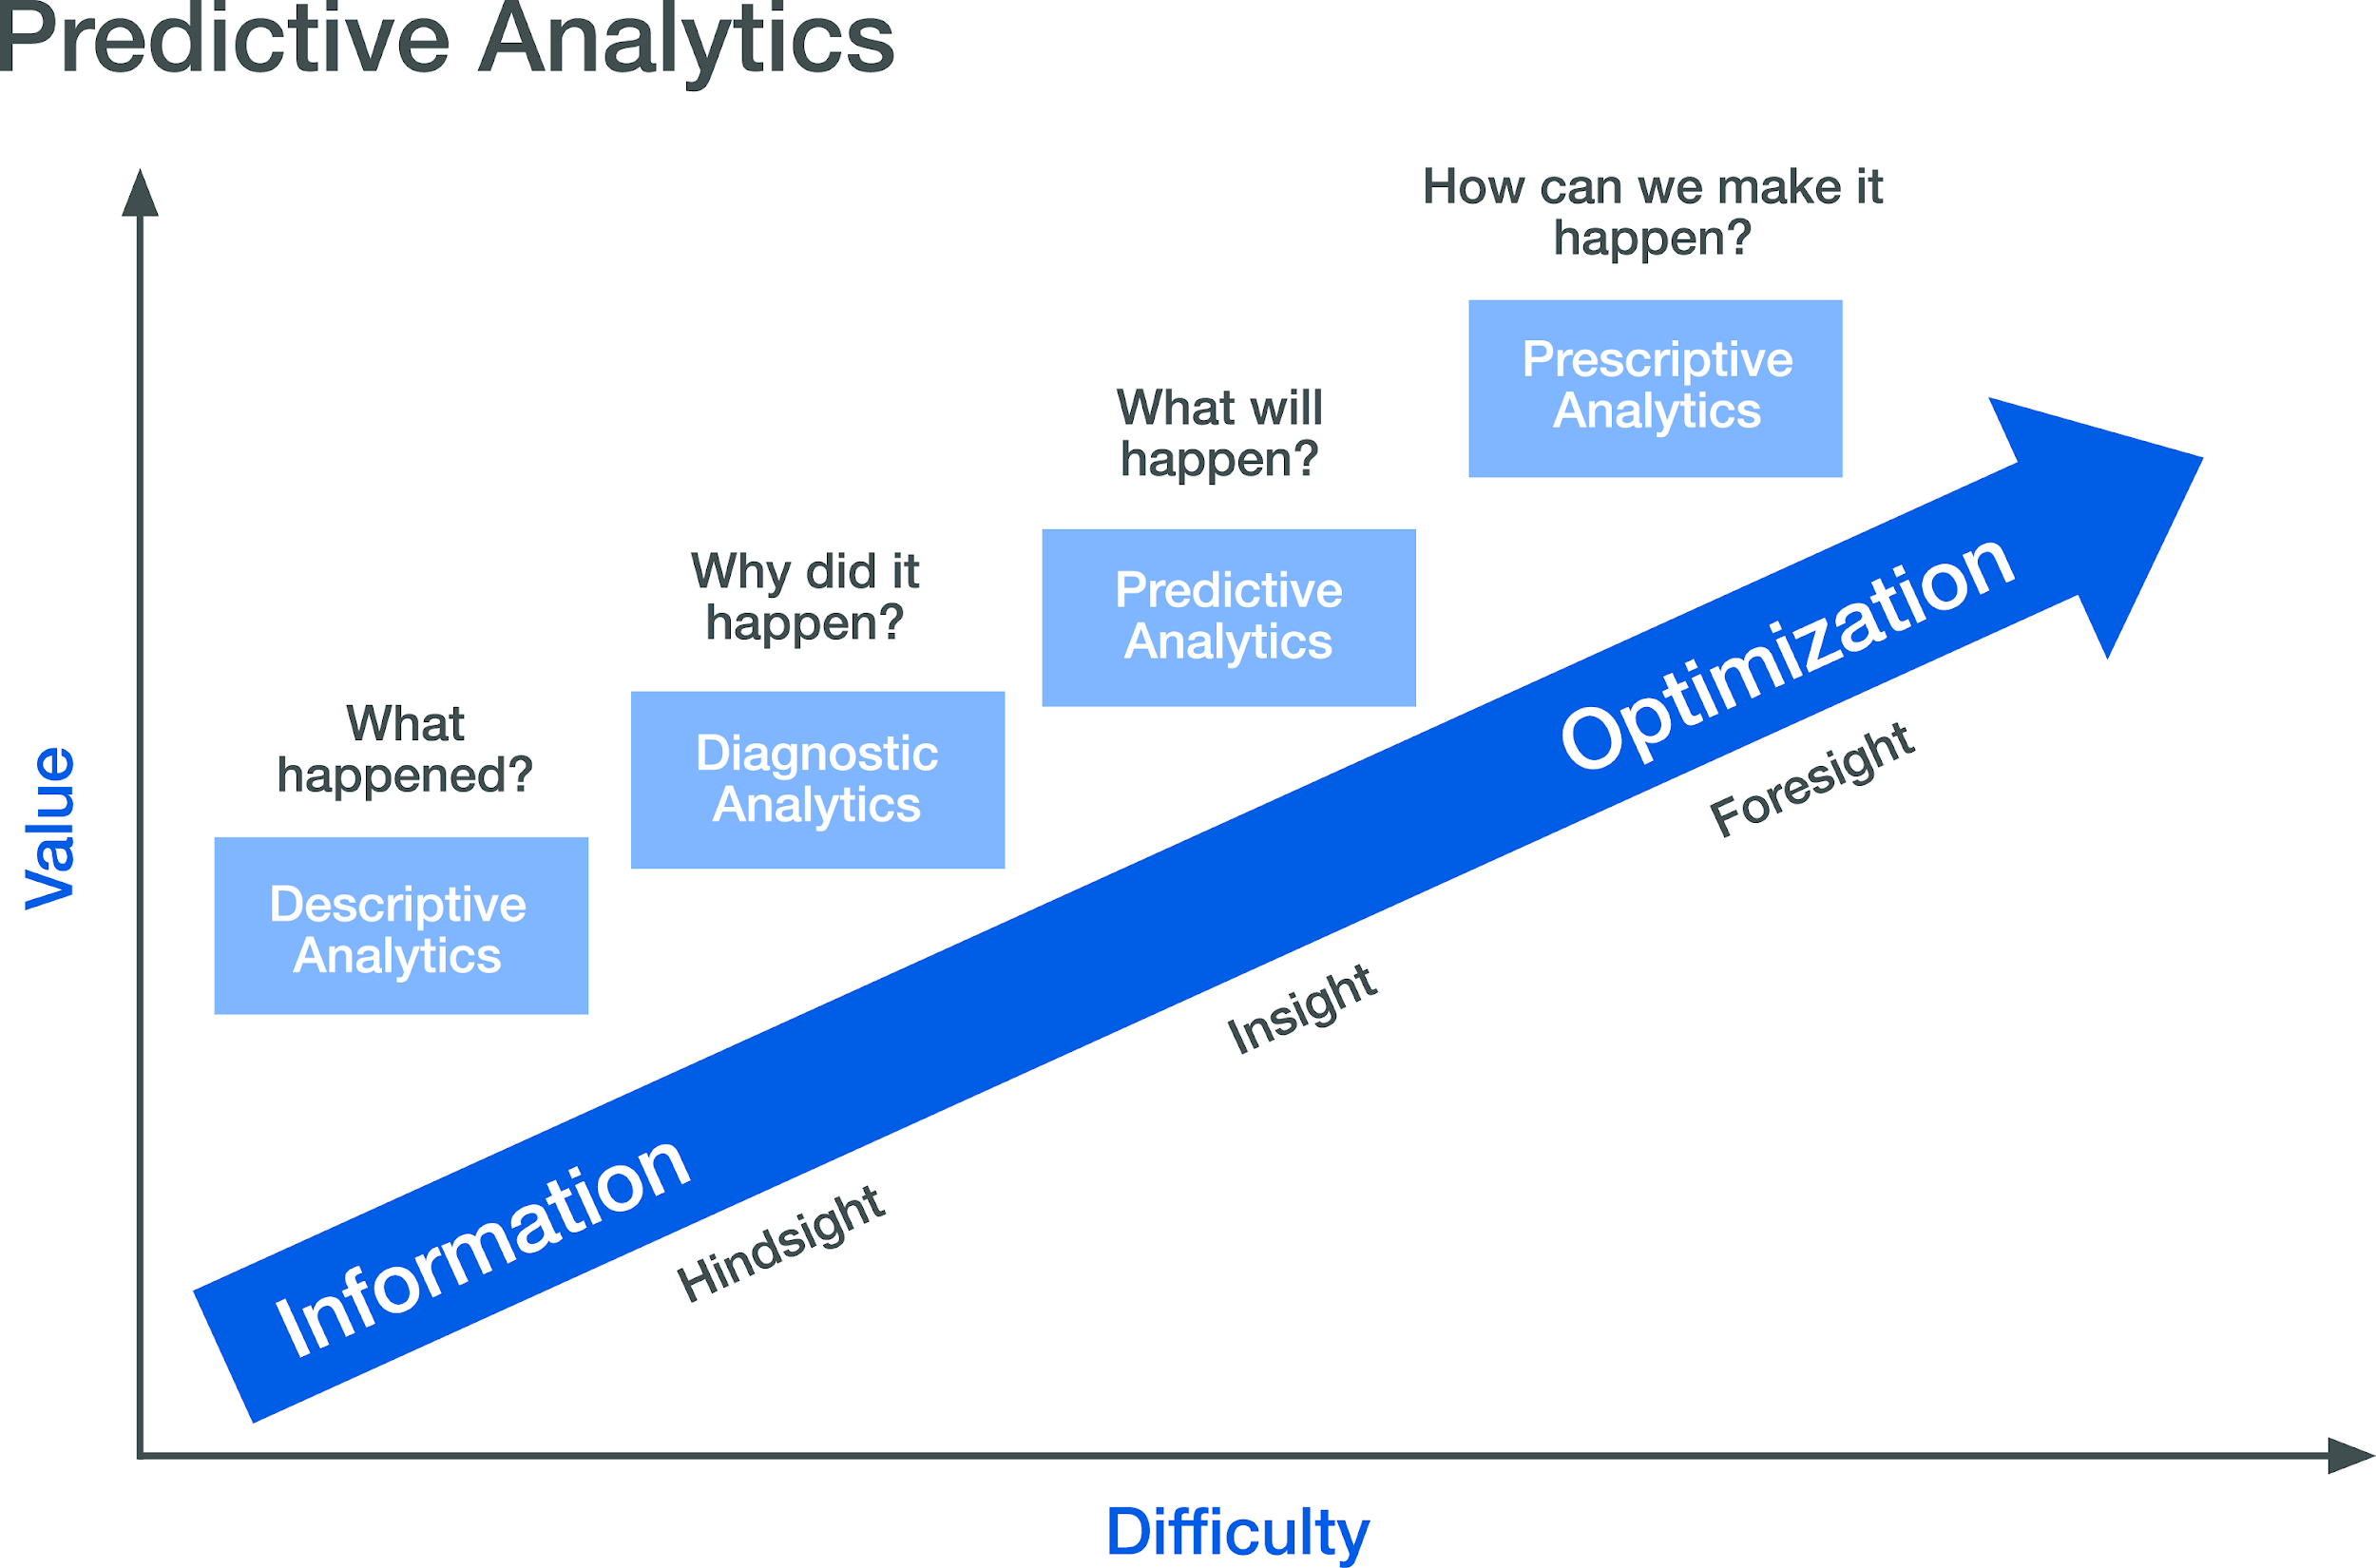
Medium time to ROI: Predictive Analytics
Predictive analytics can provide significant ROI
However, it takes time to validate the results of predictive analytics systems
Predictive analytics can provide significant financial benefit to organizations: through cost savings, revenue and discovery of business opportunities
Decision support systems can help reduce risk
Predictive analytics systems can keep an eye on markets and competition
While it takes longer to show results for predictive analytics and decision-support systems, the high value of ROI is significant
Proper staging, evaluation, and scaling of predictive analytics and AI-enabled decision support systems can deliver significant ROI

Slide 72

Longer time to ROI: Autonomous activities
Autonomous projects take the longest time to ROI
Autonomous Business Process is not an exception
Cognitive automation is not the same as Autonomous Business Process
Fully autonomous vehicles still aren’t a reality
Fully autonomous business process isn’t here yet either
Autonomous robots are starting to make an appearance, but ROI is unclear
Autonomous retail is still an experiment
Autonomy requires intelligence systems to perform at near-perfect levels, so only embark if you have long time horizons for ROI

Slide 73
Team Interaction: What’s your AI Project’s ROI?
65 min.
Step 1: Identify an AI project your organization can adopt (30 minutes)
Explore the realities behind fears and concerns and develop solutions collaboratively.
Why do these fears and concerns exist?
Determine which pattern(s) of AI the project includes
Determine how to control the scope of the project and start with the smallest problem
Determine ROI of project
Step 2: Rapid Presentations (30 minutes)
Each team of 7 (10 teams total) will have 3 minutes to share insights and solutions with the larger group.
Step 3:Wrap-Up and Takeaways (5 Minutes)
Recap project ideas, which pattern(s) most occurred, and what the ROI looks like

Slide 74
Part III:
Dealing with AI Challenges

Slide 75
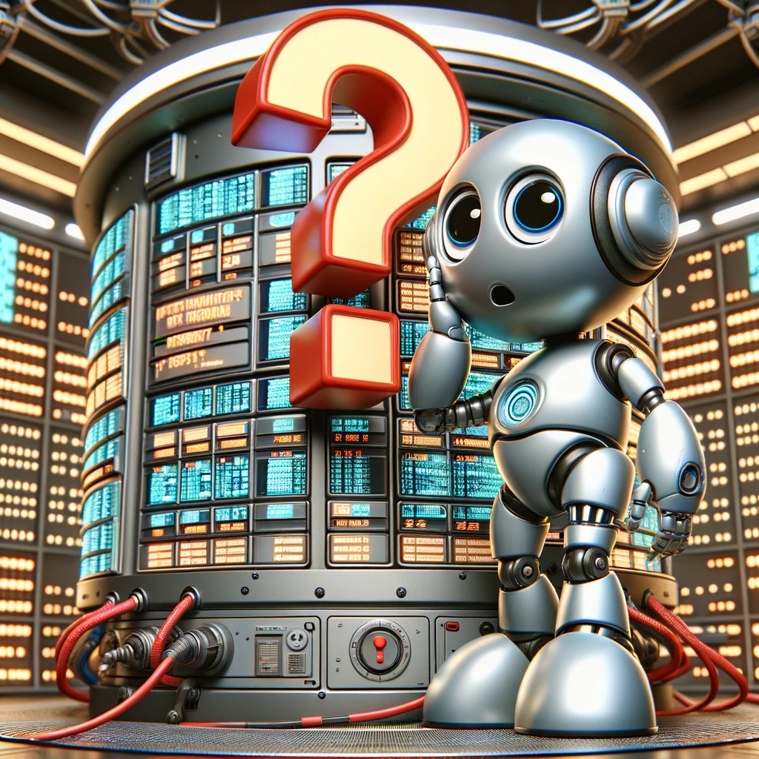
80%+ of AI Projects Fail

Slide 76
AI Failure Reason
AI projects are NOT like traditional software development projects

Slide 77
AI is Not About Application Development: It’s about Data
If you run your AI Projects like you run your Application Development Projects you’re going to find out the hard way that it won’t work.
The Seven Patterns of AI
Notes:
AI applications don’t function based on their code, they function based on their data
The code is a small part of making AI work… And not even the most important part
And.. not all AI Projects are the same.

Slide 78
AI Failure Reason
The ROI is not justified by the project

Slide 79
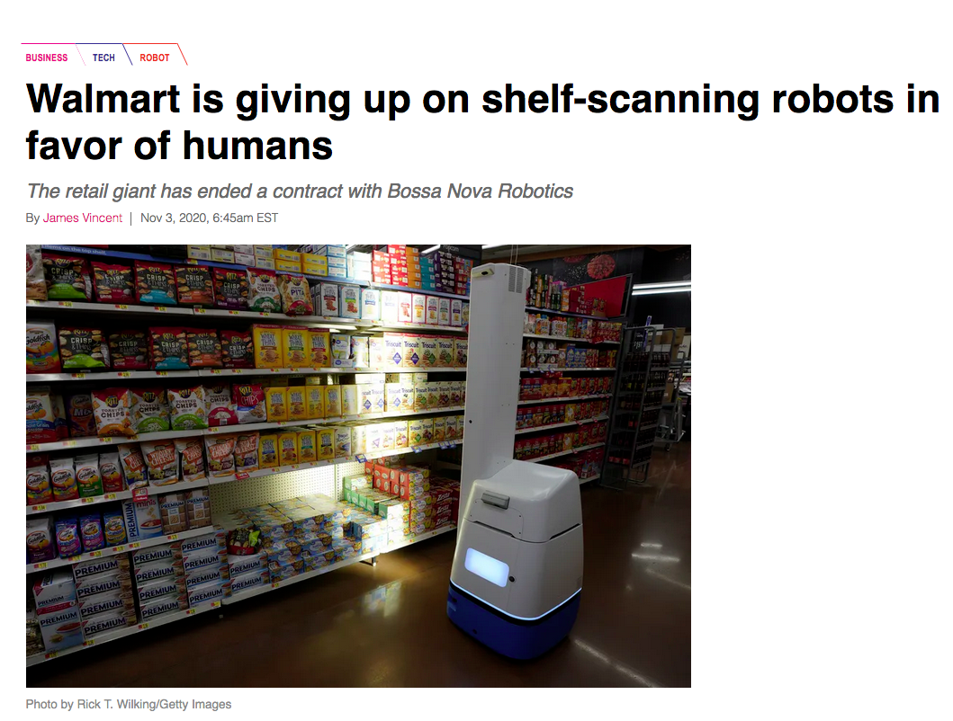
People love to fall in love with AI… until they don’t
Why was the AI project started?
What is the specific ROI?
Cost savings
Time savings
Resource savings
Improved compliance
Improved satisfaction
Lack of a real purpose is the cause of many AI project demise
Is there a better non-AI alternative?
Confusing automation with AI
Doing AI just to do AI (FOMO)

Slide 80
AI Failure Reason
Data Quantity &
Data Quality Issues

Slide 81
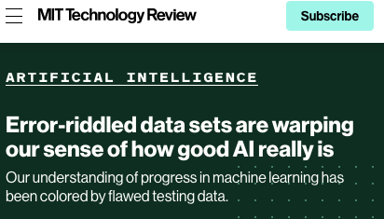
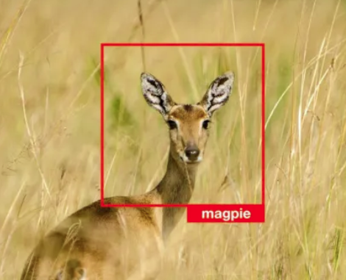
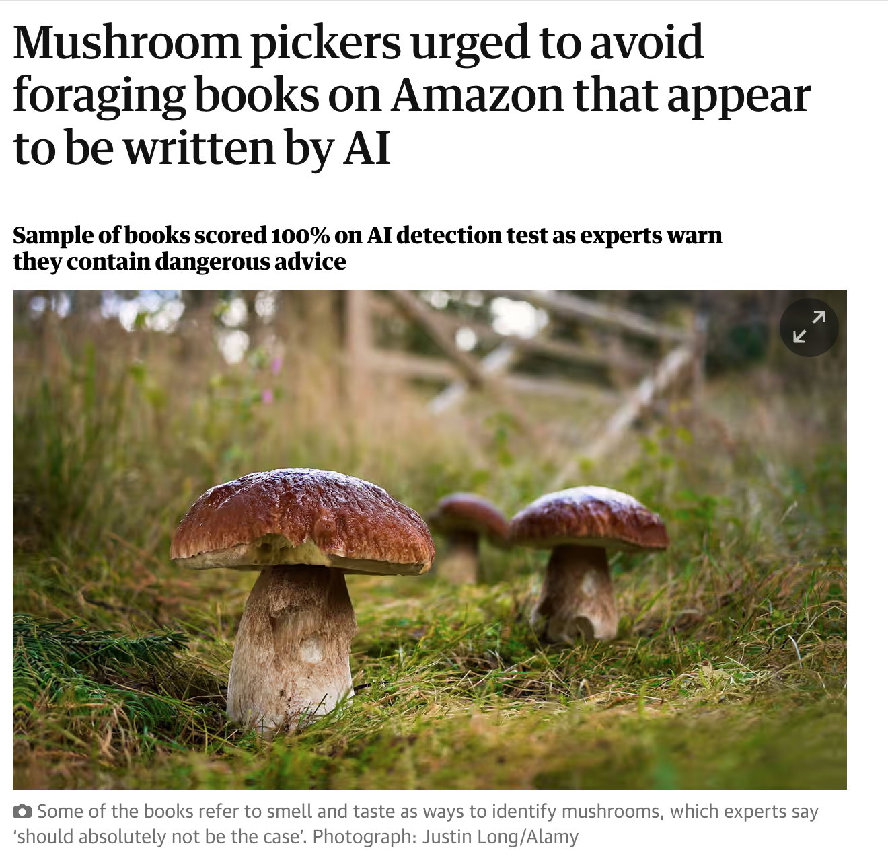
It’s All about the Data,
So Why are we Failing at it?
AI systems are trained on data, so Garbage In is Garbage Out
Data Quantity and Data Quality both matter
Notes:
Data Quantity issues:
Not understanding how much data is needed for your AI project
Not understanding what specific type(s) of data is needed for your AI project
Not knowing internal and external data is necessary
Not understanding data sources
Too little data to train, and too much to select and clean
Data Quality Issues:
Poorly prepared data with errors
Jumping into the project before the quality of data is even known
Training data quality differs from real-world data

Slide 82
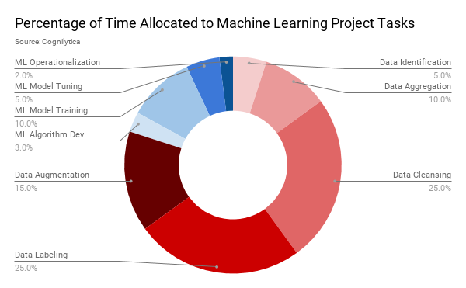
80% of AI Projects are Data Engineering

Slide 83
AI Failure Reason
The Proof of Concept Trap

Slide 84
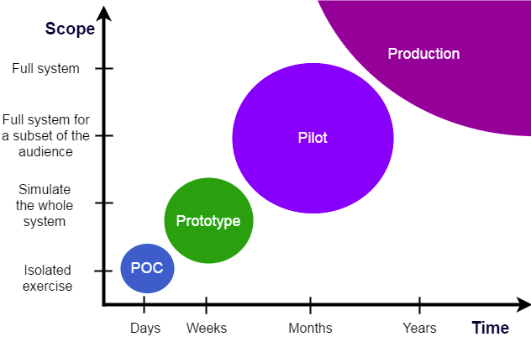
The Proof of Concept Trap
A Proof-of-Concept (PoC) illustrates a concept in an almost-but-not-really-real environment that never gets deployed into real-world production
A Pilot is a real-world project that uses emerging technologies in a protected, safe environment but used in real-world production
X
Notes:
AI POCs are easy and prove nothing
Most AI POCs Fail In Even A Basic Real-World Pilot
In any case, you’re taking TOO LONG.

Slide 85
AI Failure Reason
The Real World Doesn’t Match
Your Model

Slide 86
“Move fast and break things” doesn’t really work with AI
The real world is a lot more variable and lot messier than your training data
AI models are sensitive to all sorts of inputs you never tested
AI models can fail in some pretty spectacular and harmful ways
AI implementers aren’t testing their models properly
AI implementers often skip real Model evaluation steps

Slide 87
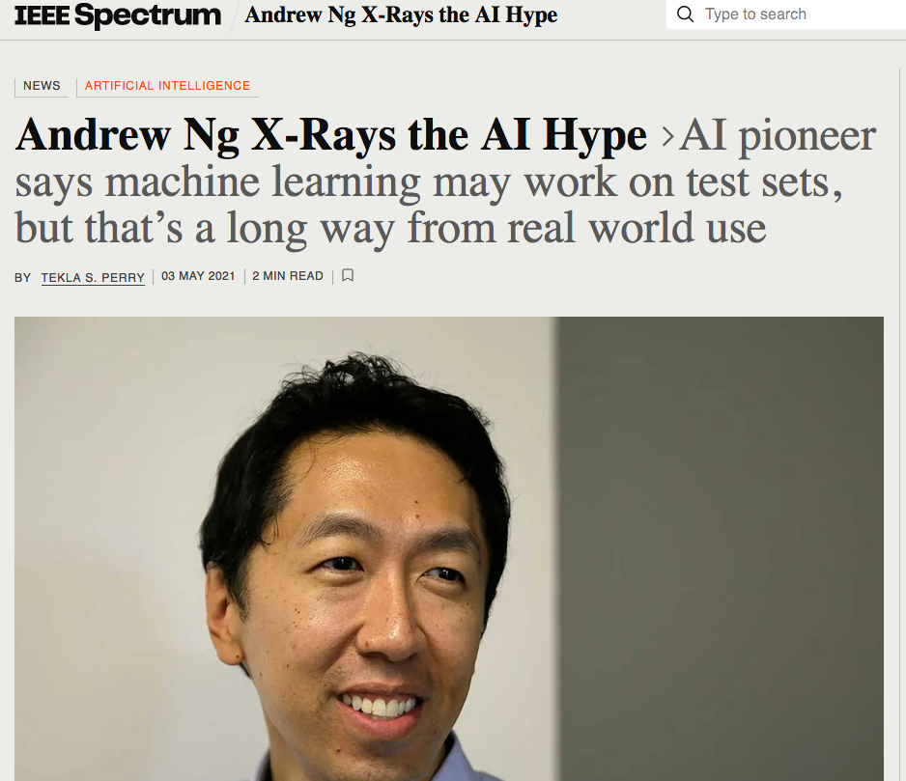
Does the real world Match your Model?
🤦‍♀ “It turns out [that when] you take that same model, that same AI system, to an older hospital down the street, with an older machine, and the technician uses a slightly different imaging protocol, that data drifts to cause the performance of AI system to degrade significantly. In contrast, any human radiologist can walk down the street to the older hospital and do just fine.”

Slide 88
AI Failure Reason
AI Project Lifecycles are Continuous

Slide 89

AI Project lifecycles are continuous
In AI, there’s no such thing as “Set it and Forget it”
Notes:
AI systems are trained on data
Data continuously changes
The real world continuously changes
AI models are probabilistic
Data drifts and decay over time
Models drift and decay over time
Failure happens when:
Didn’t budget time or resources for AI model maintenance
Didn’t account for bad things that happen when models drift

Slide 90
AI Failure Reason
Falling for Vendor Hype Product mismatch, Overhype, and Oversell

Slide 91
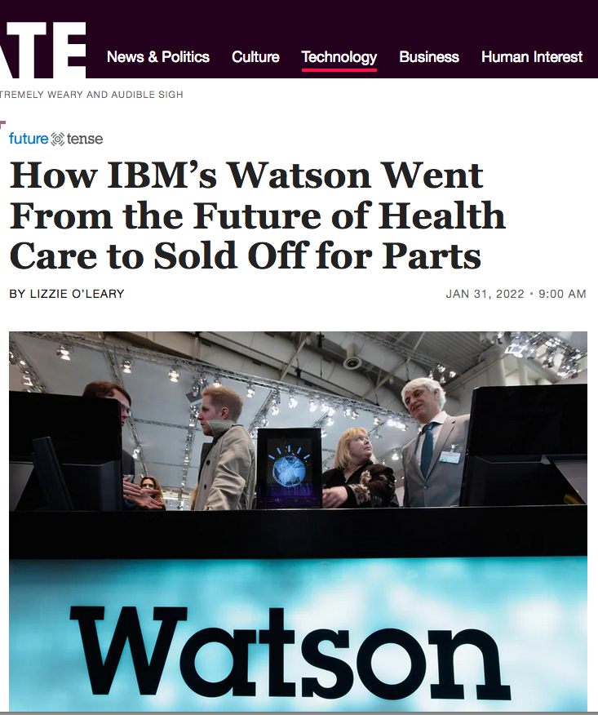
Wrong solution for your problem
Vendor misalignment on promise vs. reality comes from
Product mismatch
Overhype
Oversell
This comes from companies being a “single vendor organization”
Trying to fit a vendor square peg into a round hole
Hello… ChatGPT isn’t for everything
What makes the shareholders happy doesn’t necessarily make customers or employees happy

Slide 92
AI Failure Reason
Falling into the
Uncanny Valley

Slide 93
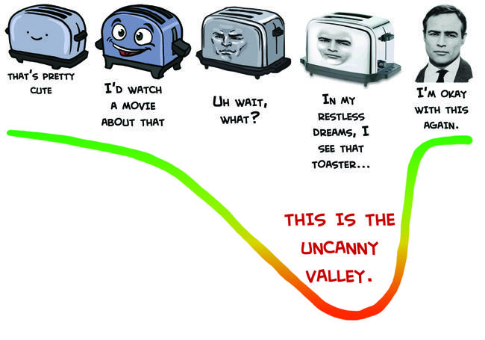

The “Uncanny Valley”
The Uncanny Valley is a relationship between the degree of an object's resemblance to a human being and the emotional response to the object.
Humanoid objects which appear almost, but not exactly, like real human beings elicit uncanny, or strangely familiar, feelings of eeriness and revulsion in observers.
The Data Version of the Uncanny Valley
Notes:
The Data Version of the Uncanny valley
Convenience vs. Privacy
Transparency & Openness vs. Security
Knowing more about you to add value vs. Pervasive surveillance
Deterioration of trust of those who hold our data

Slide 94
AI Failure Reason
Overpromising &
Underdelivering

Slide 95
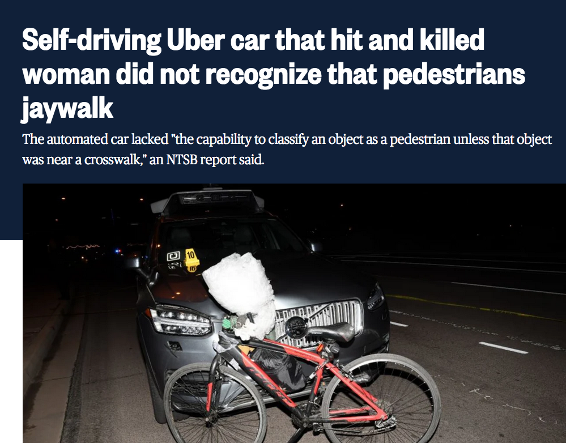
We’ve been here before
Ask yourself:
Why are we using AI?
Are we promising too much from the AI solution?
Are we more invested in doing AI then solving the problem?
Do you even know what problem you’re trying to solve?
Why are you tackling the hardest possible problem first?
Why are you trying to tackle many AI Patterns at the same time?

Slide 96
AI Project Management Best Practices
AI Project
Success is Possible.
It’s about People & Process

Slide 97
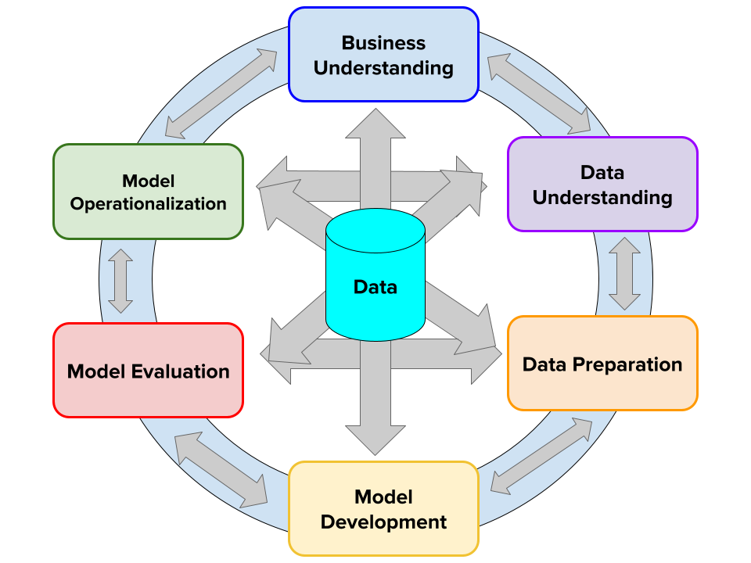
CPMAI Methodology
Think Big. Start Small. Iterate Often.

Slide 98
Think Big. Start Small. Iterate Often. A Recipe for Success.
AI Projects are Data Projects
Fortunately, we have an approach to successfully run data projects, even complicated AI projects
Cognitive Project Management for AI (CPMAI) Methodology
Extends the well-known CRISP-DM methodology that was first released in 1999 with AI specific processes and tasks
Focuses on highly iterative, data-centric phases
Driven by business understanding, shaped by data understanding
Focused on quick, real-world pilots in production, not proofs-of-concept
Vendor-neutral best-practice for running and managing AI Projects

Slide 99
CPMAI at a Glance
CPMAI Methodology provides an AI project approach focused on AI project success following six AI project cycle phases:
CPMAI Phase I: Business Understanding
AI business requirements & KPIs
AI Go / No Go
Trustworthy AI requirements
CPMAI Phase II: Data Understanding
Data requirements
Data sources
Data Quality understanding
Data Environment
CPMAI Phase III: Data Preparation
Data collection and ingestion
Data Cleaning & preparation
Data labeling & annotation

Slide 100
CPMAI at a Glance (cont’d)
CPMAI Phase IV: Model Development
Algorithm selection
Model training
Model tuning
Ensemble creation
CPMAI Phase V: Model Evaluation
Model validation and testing
Checking model performance
Re-training your model until your desired level of accuracy is achieved
CPMAI Phase VI: Model Operationalization
Using the model in the real world
Continuous model monitoring
Model optimization
Model Governance

Slide 101
Group Exercise Prep- Do you have an AI project?
We’ve just gone through common reasons why AI projects fail, now let’s not make these same mistakes
Criteria for a good AI / ML Project
Must meet a short-term organizational need
Must solve a problem that can’t be otherwise done with simpler, more predictable deterministic systems or simpler analytic approaches
Must be a “cognitive” appropriate problem (any of the following):
Would otherwise require human capabilities (recognition, classification, prediction, decision-making)
Allows scaling in ways that other technology approaches can’t
Is a 4-D’s task (Dull, Dear, Dangerous / Dirty, Demeaning)
Is a more elegant solution than a current brute-force or heavy lift approach

Slide 102

Determining AI Project Fit
Enhancing Revenue
Improving Existing Products with the power of Cognitive
Strategic Opportunity: New Product / Service
Improving Competitiveness
Entering new markets or competing faster / better in existing markets
Reducing Existing Costs
High Labor Cost vs. High Corporate Risk
Low Value vs High Value
Improving Operations
Continuous monitoring, auditing
Self-service
Unstructured information handling
Autonomous business process
Solving an Unsolved Problem
A high human labor cost problem solved by cognitive tech
The “Cool Factor”
Maybe you just want a bot roaming the halls. Is this really a good use case?

Slide 103

The AI Go/No-Go Decision
In order for an AI project to actually go forward, you need three things in alignment:
business feasibility
data feasibility
technology / execution feasibility

Slide 104
Team Interaction: Should you move forward with your AI idea?
90 min.
Teams come up with different project ideas and then go through the AI Go/No Go to determine if this AI project will be successful.
Step 1: Identify an AI project and walk through the AI Go/No Go (30 minutes)
Determine Business Feasibility
Determine Data Feasibility
Determine Implementation Feasibility
Step 2: Rapid Presentations (50 minutes)
Each team of 7 (10 teams total) will have 5 minutes to walk through their project and the AI Go/No Go answers with the larger group.
Step 3:Wrap-Up and Takeaways (10 Minutes)
Recap project ideas and what roadblocks/failure reasons might occur with their AI projects and are they ready to move forward?

Slide 105
Part IV:
Trustworthy AI Considerations

Slide 106

For AI to have Lasting Positive Impact it Must be Done Responsibly

Slide 107


The need for Trustworthy AI Systems
Trust is required for AI systems to deliver benefit
The loss of trust is very hard to earn back
Notes:
Do you trust machines to make decisions?
Do you trust that AI systems won’t harm you?
Do you trust the data that goes into training AI systems?
Do you trust autonomous systems that operate with little human control?
Do you trust organizations that collect and use your data?
Are you confident in the security and safety of AI systems?
Do you trust how AI systems are applied to you and your life?
Do you trust AI systems that will augment, or replace, your work?

Slide 108
Trustworthy AI Concepts: A Spectrum
Ethical AI
Responsible AI
Transparent AI
Governed AI
Interpretable & Explainable AI
The things you shouldn’t do or avoid doing
Guidelines
Being careful in the way that you do those things
Regulations & Laws
Provide visibility into how it’s being done
Assessments
Audit, Measure, Regulate, Guide, Secure, Provide Process
Practices & Processes
Understand System behavior and make black boxes less so
Technical Methods
Societal
Systemic
Technical
Source: Cognilytica © 2021

Slide 109




Ethical AI: “Right vs. Wrong”
AI Ethics: “AI ethics is a set of values, principles, and techniques that employ widely accepted standards of right and wrong to guide moral conduct in the development and use of AI technologies”
Bad Machines | Bad People Doing Bad Things | Bad Practices | Bad Visibility
Threatening lives Threatening freedoms Threatening control Threatening dignity Threatening environment Not in best interests of humanity | Violating our laws Violating our trust Violating our privacy Violating our lives | Lack of Safety Lack of accountability Lack of positive purpose Lack of care for workforce disruption | Limited visibility into data and processes Limited disclosure Limited consent Limited visibility into algorithmic behavior Limited repeatable, consistent processes
109

Slide 110

Why are Societal Ethics Important for AI systems?
We want machines that will comply with the most fundamental of human values
We don’t want to build systems that make societal ethics problems worse
We want to avoid physical and other forms of harm
We want to make sure systems will never be beyond our ability to control them

Slide 111

“Do No Harm”
To make AI systems trustworthy and beneficial, we need to set up systems to ensure that:
AI systems don’t intentionally or unintentionally cause human harm
The full range of “harm”: physical, financial, emotional, societal, environmental, mental
AI systems aren’t misused or abused
AI systems aren’t beyond the ability for humans to control their actions
Trustworthy AI requires Ethical AI

Slide 112

What is Responsible AI?
Responsible AI (if you do it, do it the right way) vs. Ethical AI (right vs wrong)
Just because you can do it, even ethically, how can you do it the right way?
Responsible AI doesn’t violate laws
Responsible AI doesn’t violate or abuse people’s privacy
Keep people and their data safe
Responsible AI prevents the abuse or misuse of AI technology
Responsible AI keeps people safe and secure
Responsible AI provides a well-defined trail of human accountability

Slide 113

Responsible AI Examples
Facial recognition as responsible vs. irresponsible AI
Responsible vs. irresponsible Algorithmic decision-making
Helpful User profiles vs invasive user profiles
Responsible vs. irresponsible autonomous vehicles and devices

Slide 114

AI System Safety & Reliability
AI systems should be built with safety in mind and not endanger humans through neglect or carelessness.
Reliability
Throughout their lifecycle, AI systems should reliably operate in accordance with their intended purpose
Safety
AI systems need to be resilient and safe, with a fall back plan in case of operation outside of acceptable boundaries

Slide 115

Keeping AI Systems Secure
Putting in place access control mechanisms
Auditing of model use and access
Protection of models, training data, and settings
Vulnerability analyses
Reporting on significant changes to data or operations that impact performance

Slide 116

What is AI System Transparency?
How do I know what went into making this AI system so I can trust it?
How do I know how the AI models are being built, what data has been used to create the models, what data was being included / excluded, and aspects of bias?
AI System Transparency
Visibility into all the aspects of what went into building an AI system so users can understand the full context of how an AI system is built and used

Slide 117

What can go wrong with no AI system transparency?
“The ImageNet test set has an estimated label error rate of 5.8%”
Mushroom labeled a spoon, Frog labeled a cat, High note from Ariana Grande labeled a whistle.
Without transparency, no visibility into real problems!

Slide 118
Conflicting Definitions of Transparency
Interpretability / Explainability aka “Algorithmic Transparency”
That’s algorithmic transparency, which is a technical issue we deal with later
Visibility into how the system is built aka “Systemic Transparency”
It’s even more important to know what data went into making that model in the first place.
Especially if it’s not working how you think it should!
Systemic transparency is as important (if not more) than algorithmic explainability

Slide 119

Visibility into Data
Data and configuration transparency
Visibility into training data
Methods and means of data selection
Configuration and parameter settings used
Determination of algorithm selection, ensemble method and approach
other critical technical decisions made by humans as to how the system will operate.

Slide 120

Visibility into System Design and Methods
Decision and Design transparency
AI systems should provide visibility into information about the design, operation, impact, personal data, and any algorithms used
Documenting how the model training and selection processes are conducted, the reasons for which decisions are made, and measures taken to address identified risks
Human decisions on the operation, versioning, development, and use of the AI system should be disclosed and open.

Slide 121

AI System Disclosure
Will you let people know they’re interacting with an AI system?
There should be transparency and responsible disclosure to ensure people know when they are being significantly impacted by an AI system, and can find out when an AI system is engaging with them
Violating trust when people think they’re interacting with a human, but it’s really an AI system
Shades of Deep Fake
Violating trust when people think they’re interacting with AI, but it’s really a human
“Pseudo-AI”

Slide 122

AI System Consent
Can people consent to the use of an AI system?
Users should have the right to consent to the use of AI systems
AI systems informing significant decisions should not attempt to make value judgements on people’s behalf without prior consent
Can people opt-out of the use of AI systems?
There should be a feasible alternative to the use of any AI systems
AI systems informing significant decisions should have an opt-out mechanism if it impacts people’s lives

Slide 123

Consent Questions to Address
How and when will you provide means to opt-out of the use of your AI systems?
How and when will you provide feasible alternatives to the use of AI systems?
How will you keep an eye on emerging laws and regulations that will impact the requirement to get consent to use AI systems for critical decision-making?
How will you track and manage any opt-out decisions made by your users?

Slide 124

Informational Bias Measurement
Yes, you have bias in your data.
Are you measuring that bias?
AI systems should provide a means to constantly measure bias of various sources and provide means to mitigate any bias detected.

Slide 125
Measuring Bias
If you’re not measuring your bias, then:
How do you know you’re effectively serving your audience?
How are you avoiding potential legal liability?
How do you know how to fix any issues?
How will you prove your systems are trustworthy?
What approaches will you use to measure potential sources of bias?
How will you identify potential bias issues in vendors, third-party data sets and models, or from suppliers and contractors?
How will you measure model performance against potential measures of bias?
How will you communicate internally and externally the methods you are using to measure potential bias issues?

Slide 126

What is AI Governance?
“The system by which an organization is controlled and operates, and the mechanisms by which it, and its people, are held to account”
Applied to AI:
Controls, Processes, and Organizational Structure that provide oversight, control, and visibility into different aspects of AI system design, development, management, and usage
Specifically applied to Trustworthy AI:
Controls, processes, and organizational structure that ensures ethical, responsible, and transparent AI
Notes:
Question to ask at end of slide: What can we put in place to ensure that our systems will be continue to operate within the bounds of ethical and responsible AI practices and expectations?

Slide 127

Creating an AI Audit Trail
Keep track of who, what, when, where, and why decisions are made and the data used to support AI systems
Auditability
Traceability
Notes:
Auditability
AI systems should keep a comprehensive record of data provenance, procurement, preprocessing, lineage, storage and security
Traceability
AI systems should implement an audit trail to document the full process from data collection and model training to AI-augmented decisions as well as mechanisms to capture input data streams.
Data relevant to traceability should be stored appropriately to avoid degradation or alteration, and retained for durations relevant to the industry

Slide 128

Appealing and Contesting AI Systems
When an AI system significantly impacts a person, community, group or environment there should be a timely process to allow people to challenge the use or output of the AI system
Providing a way to contest algorithmic decisions
Individuals should be provided with a means to contest automated decisions.
With or without consenting to the use of the AI system first

Slide 129

Appealing and Contesting Questions to Address
Under what circumstances will you allow users of AI systems to contest or appeal AI system decisions?
What processes and procedures will you put into place for appeal or contest of AI results?
How will you document AI systems and appeals to assist with appeal process as well as improve systems for future potential appeal or contest?

Slide 130

AI System Monitoring & Testing
AI System testing requirements
Data testing requirements
Ongoing System monitoring
Notes:
AI System testing requirements
Establish organizational standards and processes to ensure that the system is functioning at acceptable levels before being used in production.
Conduct repeatability assessments for deployments in live environments to ensure that deployments are repeatable
Data testing requirements
Verify that the data is at required levels of quality, properly stored and safeguarded, at necessary levels of relevance, in compliance with laws and regulations, and mitigated for any bias concerns
Ongoing System monitoring
Monitor the outcomes of AI systems to safeguard against unintentional outcomes and to verify compliance with laws and regulations on a regular basis.

Slide 131

Interpretable AI vs. Explainable AI
Can we understand how algorithmic decisions are being made?
The idea around “Algorithmic Transparency”
What’s the difference between Interpretable AI vs Explainable AI?
Notes:
Explainable AI:
Can the model tell you how it arrived at a particular prediction / conclusion?
“An explainable model is a … method/technique to be able to peer into the black-box and understand how the model works”
Interpretable AI:
If not, can you provide ways to understand the components of the decision-making or the key factors contributing to a result?
“Interpretability is the degree to which a human can understand the cause of a decision” or “The degree to which a human can consistently predict the model’s result”

Slide 132

Making AI Understandable
Relying on black box technology can be dangerous.
Without understandability, we don’t have trust.
To trust these systems, humans want accountability and explanation.
Notes:
Getting verifiable explanations of how machine learning systems make decisions and let humans be in the loop is key.
Not all ML approaches are inherently explainable, in particular deep learning

Slide 133

What is a “black box” with AI?
A system that doesn’t provide any transparency or understanding of how it operates in a manner sufficient to understand how specific inputs result in specific outputs.
Relying on black box technology can be dangerous.
Without understandability, we don’t have trust.
To trust these systems, humans want accountability and explanation.
Getting verifiable explanations of how machine learning systems make decisions and let humans be in the loop is key.
Not all ML approaches are inherently explainable, in particular deep learning

Slide 134

Resolving issues of Ethical & Trustworthy AI
Keep Humans in the Loop
Develop or Adopt a Trustworthy AI Framework
Prioritize Fairness and Dignity

Slide 135

Keep Humans in the Loop
As long as humans are part of the decision-making loop then issues of bias, privacy, and runaway systems can be placed into check
Provide a human point of contact with customers to maintain trust
Technology is a tool for human advancement. That’s its definition
Notes:
Cybersecurity challenges require human observation for unusual patterns that systems can be blinded to detect
Physical security will continue to be challenged from all fronts only humans can prevent further decay

Slide 136

Development or Adopt a Trustworthy AI Framework
Address all aspects of Ethical, Responsible, Transparent, Governed, and Explainable AI
Develop actionable checklists, processes, and procedures that guide all phases of AI implementation, iteration, and use
Craft guidelines and guardrails to keep AI systems safe, in check, and always under human control
Provide a way for customers and employees to add descriptive capabilities to AI-based processes
While we’re operating in an unknown future use of AI, you have the ability to control how you respond to future unknowns

Slide 137

Prioritize Fairness and Dignity
Don’t mass replace workers with an automated system without first working through workforce change issues
Can you take the Amazon approach and rethink the human worker’s role in the organization
“Take the Robot out of the Human”
Think back to the massive workforce transformation from 1950-1980 which also were some of the biggest economic boom years for the world
Shift from Blue collar to White Collar
Shift from human-based administrative support to IT-centric administration
Make sure AI-based classification and decision-making systems are fair
Involve your employees and your customers in your digital transformation and empower them.

Slide 138
Team Interaction: Identifying Trustworthiness Gaps in AI Systems
Explore real-world AI applications and identify gaps in trustworthiness.
Step 1: Each group selects or is assigned an AI use case (30 minutes)
Use cases can be autonomous vehicles, predictive policing, healthcare diagnostics, etc. Teams will discuss and identify potential trustworthiness issues across the five layers of the framework.
Step 2: Rapid Presentations (30 minutes)
Each team of 7 (10 teams total) will have 2-3 minutes to walk through their project and the AI Go/No Go answers with the larger group.
Step 3:Wrap-Up and Takeaways (5 Minutes)
Recap of what each group discussed and summarizes key insights
65 min.

Slide 139
AI Masterclass: Check for Understanding
What is a common definition of AI?
What are some common AI Myths?
What are the 7 patterns of AI?
What methodologies are currently used in technology projects?
What is the CPMAI methodology and how is it different?
What are the 6 phases of CPMAI?
What are some of the common reasons AI projects fail?
What are the 5 layers of Trustworthy AI to address?

Slide 140

Questions & Lessons Learned
Which ideas and concepts from the module were most valuable for you?
How can these ideas and concepts be implemented in your organization?
We’d love your feedback. Take this short 5 minute survey
https://forms.gle/ScWJyiK4CJ7WMeen7
Notes:
Do you have any questions related to any of the topics covered in this workshop?
What key concepts and ideas were the most valuable for you? Which do you think you can implement within your organization?

Slide 141


Stay Connected
Kathleen Walch LinkedIn
Christina Kucek LinkedIn

